Slide 1
Served Fresh Daily
Welcoming Students with an On-site, Asynchronous Tour
LOEX
2023
Notes:
This presentation (view only): https://tinyurl.com/loextour
Padlet: https://tinyurl.com/loexserved
PollEverywhere live presentation link:
https://www.polleverywhere.com/multiple_choice_polls/zgUVMxnuYn6CQYb92KhOg?preview=true&controls=none
PollEverywhere submit response: https://tinyurl.com/loextourpoll
Log in to LibApps: unm.libapps.com
Welcome to the session, Served Fresh Daily: Welcoming Students with an On-site, Asynchronous Tour. I’m Adrienne Warner, the First Year Experience Librarian at the University of New Mexico.

Slide 2
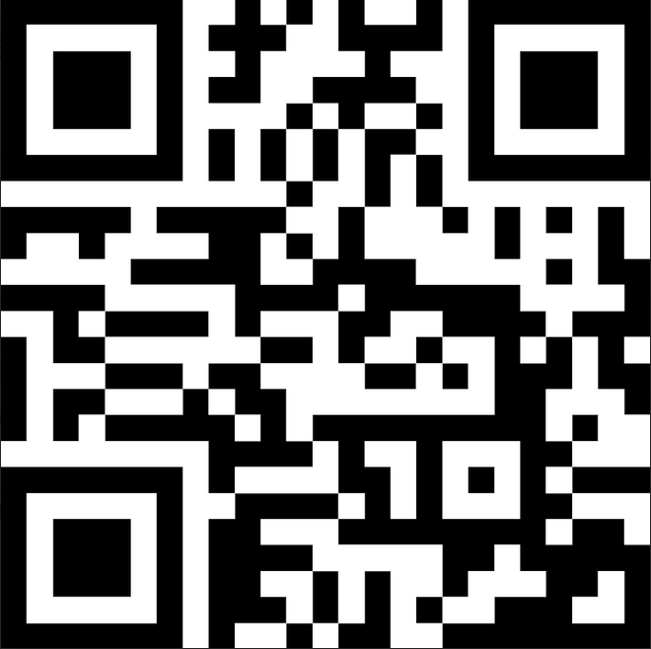
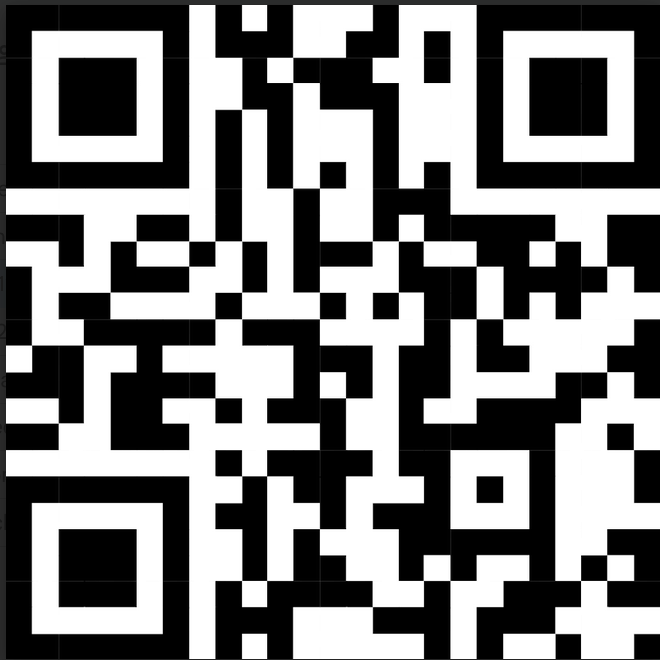
Served Fresh Daily
Welcoming Students with an On-site, Asynchronous Tour
Adrienne Warner adriennew@unm.edu
Slides, Q&A
tinyurl.com/loexserved
LOEX
2023
PollEverywhere tinyurl.com/loextourpoll
Notes:
You should have gotten a half sheet with some QR codes. The top QR code is a link to a Padlet that contains the slidedeck and space for Q&A. You’re welcome to submit questions there or in person at the end of my remarks.
The bottom QR code will take you to a poll about your interest in tours. If you haven’t already taken that poll, please do so. And no judgement on what brings you to this presentation.

Slide 3
AGENDA
Context
Design
How it works
How it went
Served fresh
Q & A
Notes:
While you’re doing the poll, I’ll outline what we’ll be talking about during this session. I’ll give you some context as to how this project came about, how I designed the tour, how it works, how it went, why I like it as a fresh instructional offering, and time for Q&A.

Slide 4
Poll Results
LOEX
2023
PollEverywhere tinyurl.com/loextourpoll
Notes:
But first, let’s check out the poll results. [Ad lib regarding results]

Slide 5
Context
1
Notes:
So now that I know a little bit about where you’re coming from, I’ll give you some insight into why I chose this project and where it sits in the professional landscape.

Slide 6
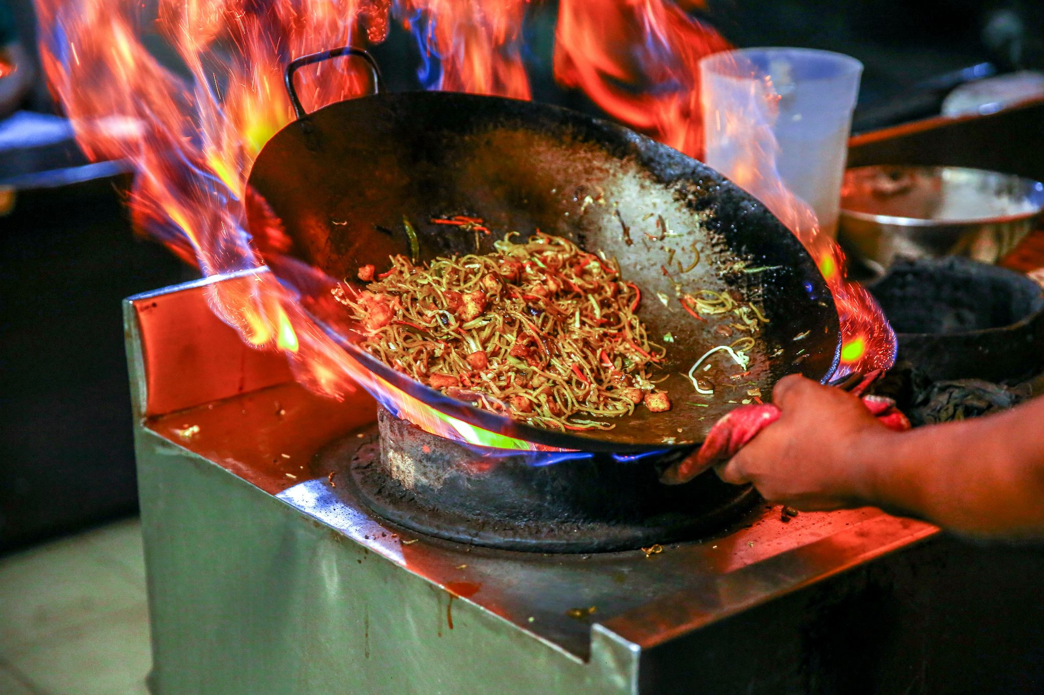
Cell phone view
Notes:
The flash-in-the-pan encouragement for me to create an asynchronous tour came about in Fall 2022. I received an instruction request from the coordinator of the Arts & Sciences Introduction to Research Class. She asked if I could get the students into the library for eleven sections. In one week.
I politely declined but offered to put together a tour the students could complete on their own as homework, or if instructors wanted to take a class period to conduct the tour together, they had that option as well. Thankfully, my negotiation with the Arts & Sciences coordinator worked and this pilot project was born.

Slide 7
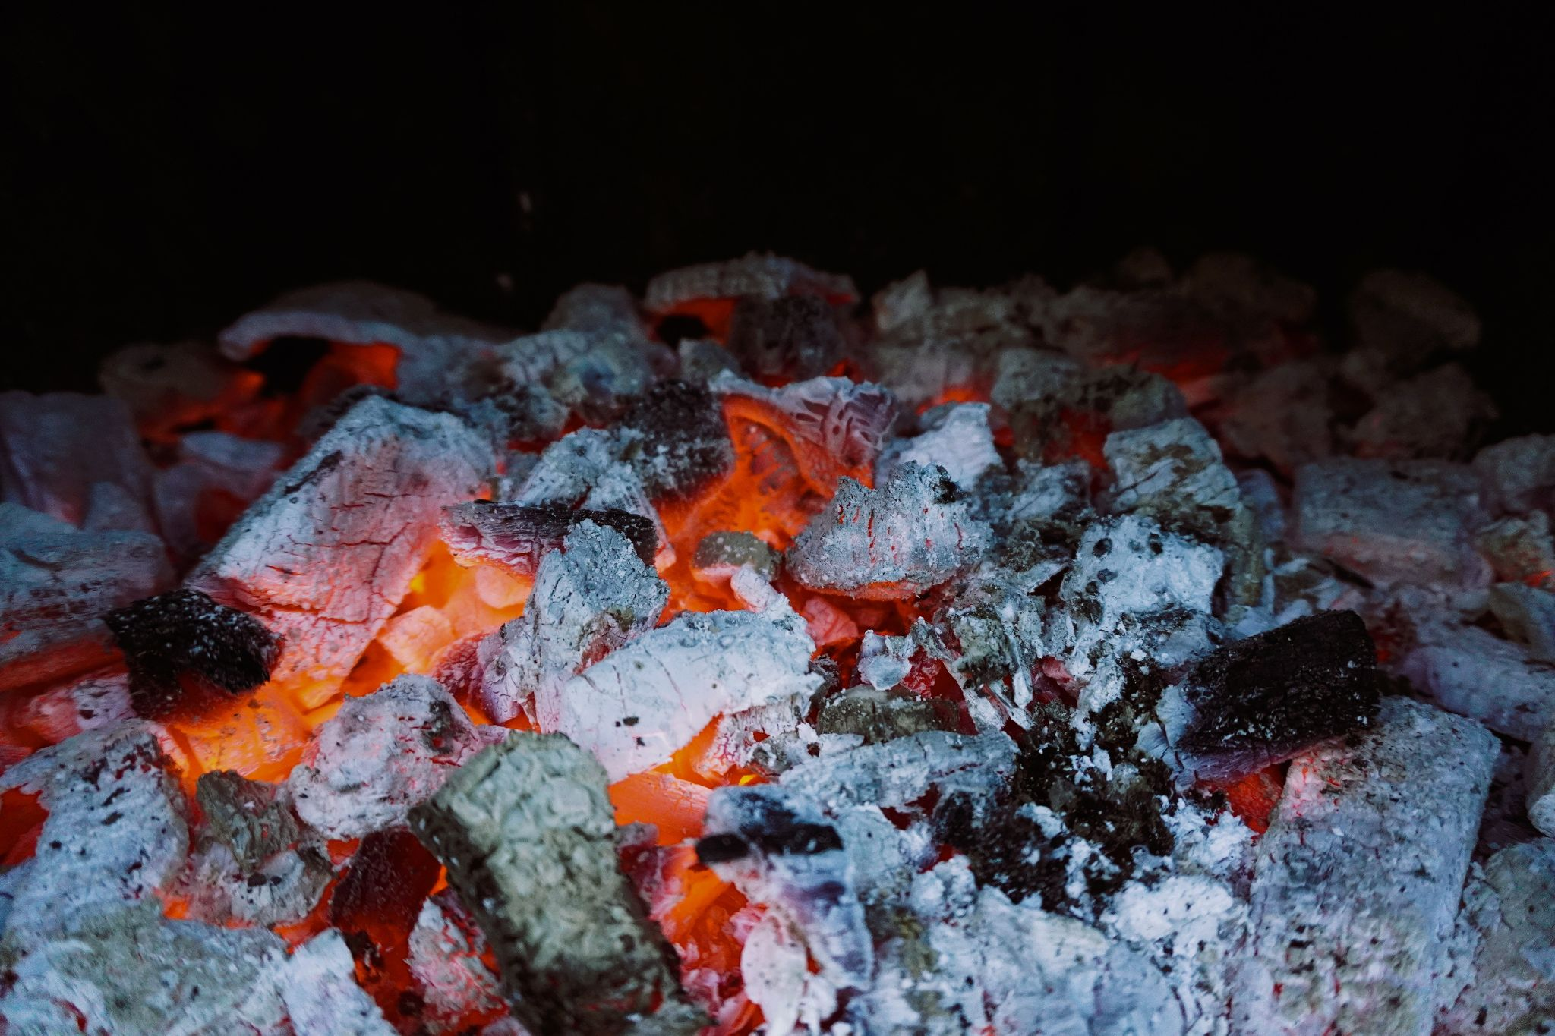
Cell phone view
Notes:
But the problem of tours had been slowly burning in the back of my mind for years. Back in 2019 when I first started in my position as First Year Experience librarian, I got a LOT of tour requests from first year seminar instructors. I honored as many as I could, showing whole classes around our library, and sometimes recruiting colleagues to split the groups in two to make it more manageable. But they never seemed like a good use of my time or the students’ time. I could never tell if they got anything out of it, or even if they could hear what I was saying. I got burned out. At the end of the fall semester, I vowed I would never do another tour.
Tours were also a pain point between departments. The Access Services department would get asked for tours on-the-fly when groups arrived and they didn’t have the capacity to drop everything to provide the tour. Yet in the instruction and outreach department to which I belong, didn’t really have a sustainable solution as I mentioned.
And then the pandemic lockdown happened and tours were out of the question. Our library buildings closed, reopened, and now years later, are slowly building up library users once again. But our space usage stats are nowhere near where they were pre-pandemic.

Slide 8
26,000 FTE
3,509
HSI / R1
Fall 2022
FY students in fall 2022
Notes:
I’ll give you a quick overview of my institution and the most recent First-Year student cohort. The University of New Mexico is the largest university in the state with an average enrollment of 26,000 FTE, and of those about 3500 are first year students. This is the 3rd largest FY cohort in the institution’s 100-year history.
We are also a Hispanic-serving Institution and are classified as a Carnegie R1 highest research activity institution.

Slide 9
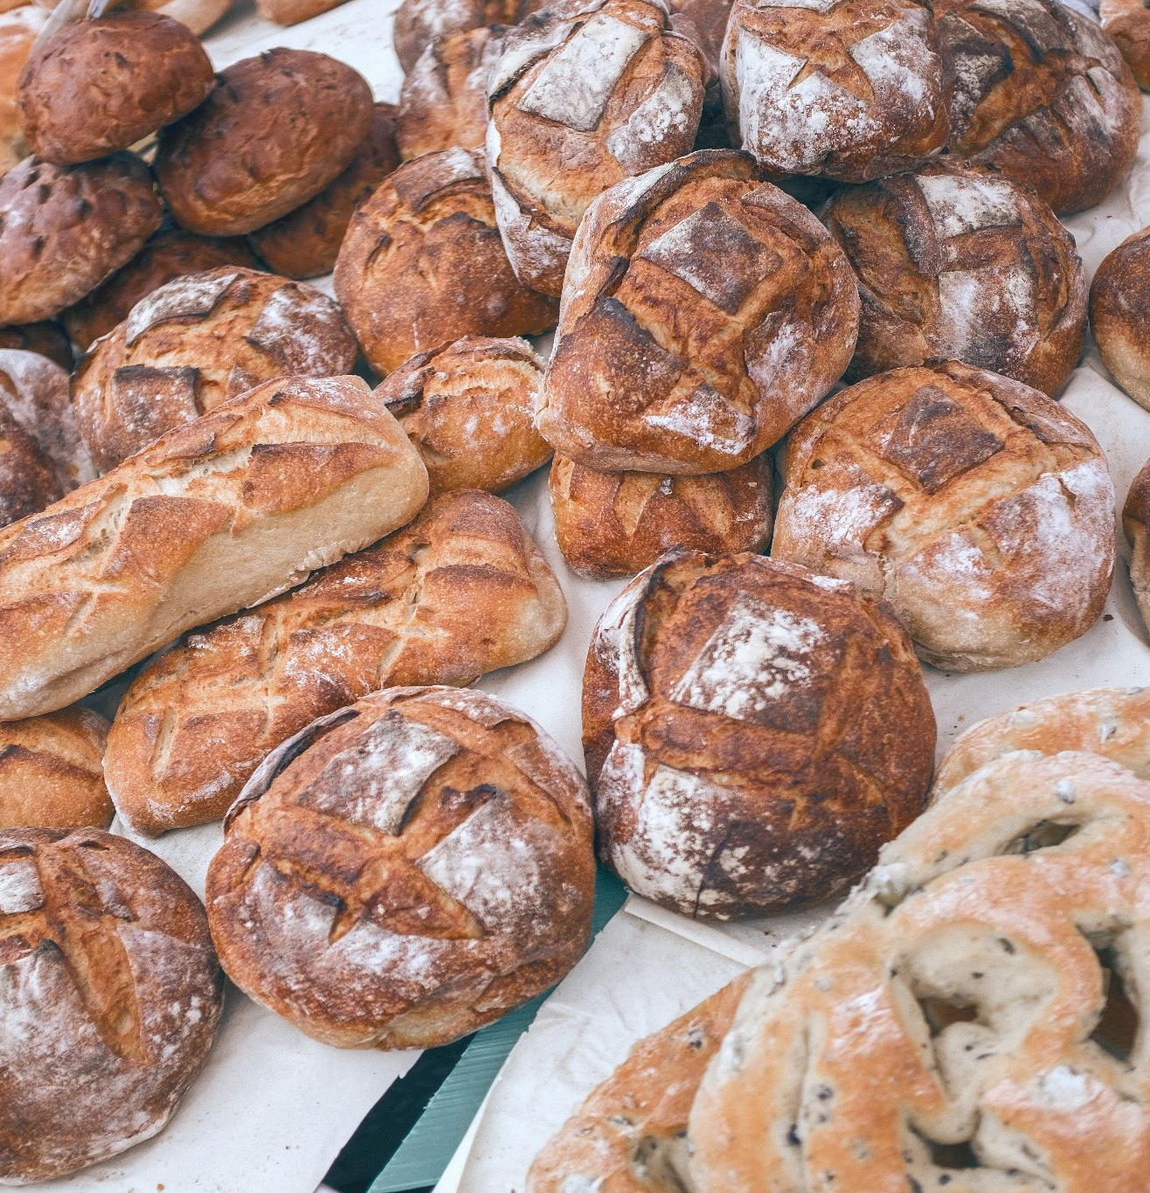
Broader Context
Notes:
Let’s consider the broader context of tour offerings at the professional level and outside of our discipline.

Slide 10
Bring up the topic of guided library tours at any conference or gathering of instructional librarians and it becomes immediately clear that tours are no longer in “vogue.”
-Pixey Anne Mosley, 1997
Notes:
The sentiment for library tours can best be summed up by this quote. [READ QUOTE]. So first let me commend you for not caring about looking trendy!
In my research, time and again, I saw similar sentiments, mostly that tours were outdated and offered mixed learning results. Mosley was interested in keeping tours around and proving their effectiveness, so she was not a hater, but unfortunately her research did not stem the tide of disdain.

Slide 11
Broader Context
Notes:
But up until widespread use of the internet, tours had been a standard offering in academic libraries. In a 2002 survey, 93% of ARL libraries offered conducted tours. But librarians had been experimenting with self-guided tours for decades, starting with printed leaflets in the 1960s and progressing to cassette tapes and CD-ROM in the 90s. Shortly after the integration of the internet into our work, tour literature morphed into “orientation” literature, and with it, gamification and virtual tours. After this 2002 survey, there has been little national data on whether and how tours are offered.
But researchers in other fields are still interested in tour best practices, especially in museum and cultural heritage studies. In a 2017 analysis conducted at a cultural heritage site in England, researchers found that the act of being guided through an audio tour via cell phone had a more positive effect on participants than those who got the “free choice” option to visit areas of the site that appealed to them. They also found that both kinds of tours, whether guided or “free choice”, were better at facilitating more personally meaningful connections than no tour at all. (Petrie et al.)
In 2021, museum studies researchers found that having audio descriptions of visual works improved visitors’ recall of artworks. They found that not only do the audio descriptions tell people “where to look,” but by providing social and historical context alongside shapes and colors, they also showed people “how to look.” Ultimately, they found that audio descriptions helped visitors have more meaningful connections with the works. (Hutchinson)
I think we can take a page out of these studies and begin to take library tours seriously again as a tool of engagement with students toward their success. I’m sure most of us are aware of the library studies that are continuing to come out regarding the link between library use and persistence and graduation. In my view, there’s an opportunity to refocus on engagement with spaces.

Slide 12
Project Design
2
Notes:
Now that we have some background at the personal, institutional, and professional levels, let’s get back to the tour at hand. Here’s how I designed the tour.

Slide 13
Backward Design
Stage 1
Desired Results
Stage 2
Assessment
Stage 3
Plan
Activities
Wiggins & McTighe 2005
Notes:
The short answer is that I used Backward Design.
I’m sure many of you are already familiar with this, so I won’t spend a ton of time what backward design is. Essentially, in backward design the thought is to start at the end, first identifying desired results and working backward to designing activities. Wiggins & McTighe’s 2005 book came in handy for me.
For the tour, I envisioned several practical components. I knew it had to be asynchronous, as I was not going to repeat my earlier mistakes. I wanted students to be able to complete it in 40 minutes, including travel between stops, and I didn’t want each stop to be longer than 5 minutes. I knew I had to include introductory content in the first stop, and concluding content in the last. I knew the tour stops had to follow and a logical route through the building.
For the desired results of what students would get out of the tour, I had two objectives. First, I wanted to the students to come away feeling like they had more confidence in using the library. Second, I wanted them to understand the variety of space options available to them beyond what they could see from the foyer.
I made a list of what I didn’t want. I didn’t want to overload the students with process minutia, like how to find a book in the catalog, get the call number, and find the book on the shelf. So I don’t cover that in this tour. I also didn’t want the tone to be stilted and formal, so although I had a script, I didn’t read it and I added a few ad-libs. I did not say the words “reference” or “circulation.” I also didn’t want it to be boring as just a dry recitation of what they could see for themselves. To counter this, I solicited personal stories from student employees to add depth to the human element of the tour.
For stage 2, where you determine acceptable evidence or assessment, I created the survey, which asks about whether students feel more confident after taking the tour, and asks them to recall something that stood out to them.
In stage 3, I planned the activities for each stop. Some stops have them just standing in the original location, and some have them go on little side-trips looking for specific spaces and windows.

Slide 14
Design Thinking
Discovery
Notes:
I also borrowed a little from the process of design thinking, a five step, iterative process. I won’t go into all the steps here, but the one I want to highlight with you is the first stage, which is discovery. The essence of this phase is to discover as much about the people I was designing for via empathetic means. In my case, I tried to imagine what someone new to the space would see, hear, smell, and experience spatially. I thought about the library from the perspective of someone who has never seen the library website or maybe even a library. I considered whether I would feel if I had permission to go behind closed doors or through small, unlabeled hallways.
In addition to using my own empathetic imagination, I also read a lot. I read library studies that talk about people’s recollections of their meaningful library experiences. About embodied cognition of library spaces. I won’t go into all the studies that informed my thinking about the intended audience, but I will highlight two.

Slide 15
Significant Research
On the Experience of Libraries
Kracker & Pollio (2003). The Experience of Libraries Across Time: Thematic Analysis of Undergraduate Recollections of Library Experiences. Journal of the American Society for Information Science & Technology.
Notes:
The first is a study called, “The Experience of Libraries Across Time: Thematic Analysis of Undergraduate Recollections of Library Experiences.” With this study, Kracker and Pollio sought to answer the question, “how do people experience libraries?” using phenomenological methodology. The study traced the development of undergraduates’ experiences of libraries from preschool to college, mining what most stood out to them about these experiences. In short, the qualitative feel and meaning of the library changed over time, and once in college, the size of the facility and the abundance of information available are central to the experience. Feelings of being lost and confused in the space are prominent.

Slide 16
Significant Research
On the Experience of Libraries
Cox, A. M. (2019). Learning bodies: Sensory experience in the information commons. Library & Information Science Research.
Notes:
In Andrew Cox’s study, “Learning Bodies: Sensory Experience in the Information Commons,” he explores embodied cognition, or the role of the body in thinking and learning. He uses the example of gestural cognition, like when we gesture when talking, which not only helps to get our point across, but is also tied to the gesturer’s thought process. When we think about our bodies in space, we have to think about our perception, or how our bodies receive information from our environments. In his article, Cox goes beyond the 5 senses, discussing current understanding of at least 10 sensory systems. He talked to 8 university students about the attributes of their chosen spots in the library. More than anything, though, this article describes in nuanced terms reasons why different kinds of spaces matter to students, from being situated in a corner, enclosed by bookshelves, the visible perspective as well as how visible one is to others, the soundscape. It paints a rich tapestry of the complex factors that go into choosing where we want to be in the information commons. But at the heart is that we want to have control over our surroundings or at least which surroundings we choose to be in. For this reason, it seemed highly important to give tour listeners a wealth of space options.

Slide 17
How It Works
3
Notes:
I’ve talked a bit about how this project came about, and now I’ll talk about the components of the tour and let you listen to a tour stop.

Slide 18
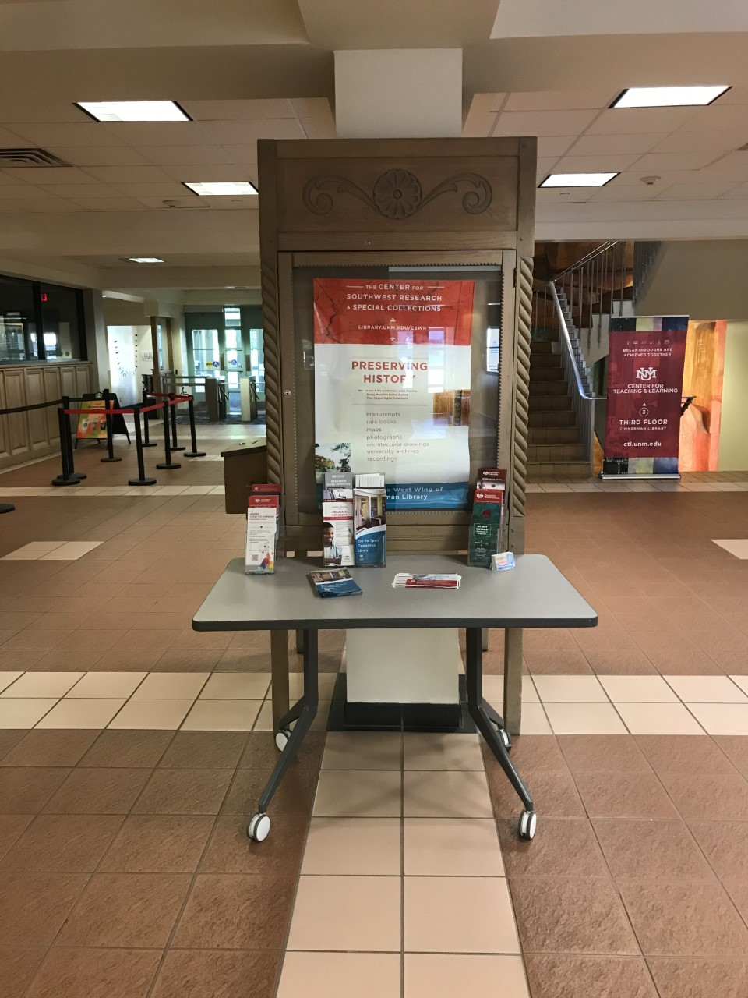
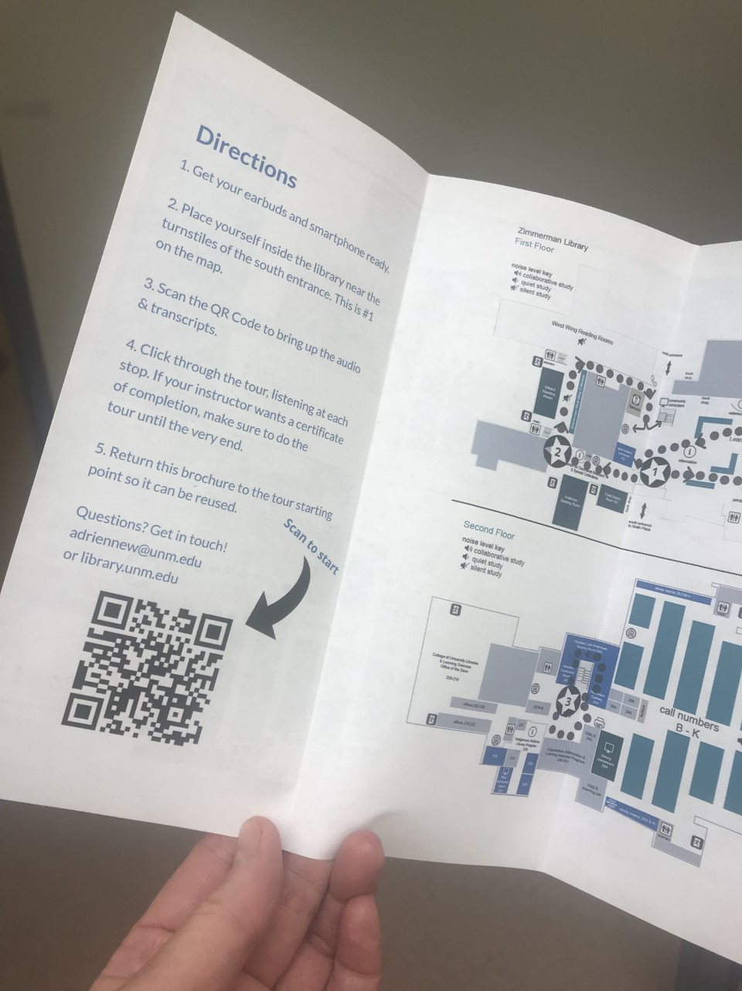
Print
&
Tech
Notes:
The tour uses a combination of printed material and technology and relies on students’ bringing their own smartphones and earbuds. They come into the library’s foyer and pick up a map at the table. They read the directions and scan the QR code, which brings up a LibWizard Tutorial, which looks like this. [transition to live demo of tutorial.]
Students see the welcome page and a “begin” button. Then, they read instructions about how to play and pause the video, and the option to open transcripts. They watch or listen to each stop’s voiceover, which is hosted on Youtube. Let’s listen to stop #2.
[Play and BRING UP CAPTIONS.]
They go through all five of these stops and at the end, they respond to a survey that is a mix of reflective questions and whether they found the tour helpful. Finally, they are emailed a certificate of completion that they can turn in for proof of attendance.

Slide 19
On Site
No online option
Notes:
Because one of the objectives of the tour is to get students into the physical library, I had to make sure that the map could not be accessed and completed off-site or online. Many other libraries host on their websites prerecorded tours, but that addresses a different objective. Because this tour relies on the printed map as the first step, it’s vital to keep the maps stocked and in a predictable location.

Slide 20
How It Went
4
Notes:
The tour went live at the end of October 2022. Here’s how it went.

Slide 21
203 survey responses
94% FY students
86% more confident
In first 6 months
Target audience
Using the library after taking the tour
Notes:
In these first 6 months I’ve received just over 203 survey results. 94% of participants were first year students, so I knew I hit my target audience.
If you’ll remember, one of my original objectives was for students to come away feeling more confident about using the library. With that addressed, I could turn to look at how my second objective fared.

Slide 22
Beyond the Foyer
“Thinking back on the tour, what sticks out to you?”
Notes:
My second objective was that I wanted them to understand the variety of space options available to them beyond what they could see from the foyer. One of the questions in the survey that addressed this objective was, “thinking back on the tour, what sticks out to you?”
The vast majority of responses recalled spaces not seen from the foyer. Of the specific places in the library students named, those not able to be seen from the foyer accounted for 89% of what students remembered, and only 11% of what they could see from the foyer. So the second objective was met, as well.
In my initial coding of the qualitative data, several themes have stood out to me.
The first is feelings. Several students included feeling words in their recollections, including previously being scared or unsure about venturing into different parts of the library. One student responded to this question about what stood out to them saying, “The archive research room on the first floor. I have never seen that room before and was scared because I thought it was not able to be accessed by students.”
Another student said, “The basement stuck out to me because I was always scared to go down because I didn’t know if it was open for students or just the professors.”
There was also a theme of sensory experiences related to the colors, smells, level of noise, and the bodily perception of space. Several students commented on being happy the library is a no-shushing zone and that they can find the space environment just right for them. One sensory system is the proprioceptive one, which is how we’re aware of our body positioning. One student illustrates the preferred soundscape and their relative position in the west wing when they answered, “Definitely the design of the silent study area on the first floor. It’s amazing how after a left turn from the Starbucks and walking through a small hallway that you’re introduced to a HUGE room full of silence. It’s very peaceful.”
There was also a theme of being encouraged. Several students remarked about being able to see themselves taking advantage of spaces or services in the future. To illustrate, one student said, “What really sticks to my memory is when they talked about the the 3rd floor and that really smart people are the ones that seek tutoring because they are trying to have a bigger understanding on assignments.”
Finally, the most surprising result to me is that students themselves were surprised. They exclaimed about finding out something new about the library, even though I didn’t ask for one thing they learned.

Slide 23
Served Fresh
5
Notes:
In addition to the overwhelmingly positive feedback, this tour offers value added features that make it a fresh offering.

Slide 24
Students
Notes:
There are some student-centric improvements that really elevate this over the traditional tour. First, accessibility. Students can easily control the volume, toggle captions, use transcripts, and pause or rewind the voiceover. People with varying mobility needs can set their own pace.
In addition to the improved accessibility features, the tour itself is more available to students since they can take it any time the library is open.
These tangible features would be enough, in my mind, to continue offering this program. But there are intangible benefits, too.
We often talk about how important it is to build relationships with faculty and instructors. But how often do we think about building relationships with our students? Not only is the tour is an excellent icebreaker, allowing the students a low-stakes intro to the library, but it’s also a way to frame how students can use - and do use - the library.
None of us inherently know how to use the library. I was talking to a high-ranking UNM official about his undergraduate experience and he said he never used the library because he didn’t know what he was supposed to do there. This was shocking but rang true. What he said was important to my project because it meant I needed to explain what students do in a library, and explicitly grant them permission to do things there. I needed to norm what to do in a library. Not only that, I needed to show students they had the power to choose what to do in a library and which space they want to do it in.
If, as the FY Librarian, I do not show and tell students what happens in a library, I may be inadvertently telling them the library is not a place for them if they can’t figure it out on their own. Without laying a baseline of what happens in library spaces, I might have been adding to the hidden curriculum that harms so many students. On the other hand, by showing and telling about library spaces and practices, I could not only tell them how things work, but give them power in the process. As Joseph Raz says in his central book on practical reason and norms, permission-granting norms confer power, and the tour was my vehicle for conferring that power to students.

Slide 25
Instruction Program
Notes:
But the tour is a fresh offering for our instruction program, too. It has become an important menu item, going beyond filling the initial need of getting students into the library for those 11 sections, but also serving in a flipped classroom model. It works great as a homework assignment before the information literacy classroom session, allowing the students to get to know the space and to find the classroom before the actual session.
It’s also scalable. I won’t underestimate the time it took for me to put this together, which was around 60 hours. Like anything worthwhile, it takes time to create a thoughtful tour, but once it’s up and running, the tour can just as easily accommodate 50 or 500 students.

Slide 26
What Next?
7
Notes:
When I consider the future of this project, I am excited that it is set up to run for the next several years unaltered. I received a grant to further making this tour more inviting for students who speak Spanish and / or Dine. I plan to create a companion tour that will delve into more of the archives and history of the building, in response to the evident enthusiasm for these.
As you consider the myriad circumstances that might lead you to develop a project like this, I encourage you to remember yourself as a primary stakeholder. It’s likely you have a pretty good idea whether there’s current demand for a project like this.

Slide 27
The library is a phenomenon, not a building, not the people. It is an EXPERIENCE, one that never repeats, but continues to evolve with every intentional act.
-George Fowler
Notes:
I’ll leave you with a final quote. [READ QUOTE]

Slide 28
References
Cox, A. M. (2019). Learning bodies: Sensory experience in the information commons. Library & Information Science Research, 41(1), 58–66. https://doi.org/10.1016/j.lisr.2019.02.002
Fowler, G. J. (2016). The essence of the library at a public research university as seen through key constituents’ lived experiences [Ph.D., Old Dominion University]. https://www.proquest.com/docview/1866345291/abstract/AF7F3B4BCA3B4E01PQ/1
Hutchinson, R., & Eardley, A. F. (2021). Inclusive museum audio guides: ‘Guided looking’ through audio description enhances memorability of artworks for sighted audiences. Museum Management and Curatorship, 36(4), 427–446. https://doi.org/10.1080/09647775.2021.1891563
Kracker, J., & Pollio, H. R. (2003). The Experience of Libraries Across Time: Thematic Analysis of Undergraduate Recollections of Library Experiences. Journal of the American Society for Information Science & Technology, 54(12), 1104–1116. https://doi.org/10.1002/asi.10309
Notes:
Here’s page one of the references I used [pause & count to 10]

Slide 29
References, continued
Mosley, P. A. (1997). Assessing the comfort level impact and perceptual value of library tours. Research Strategies, 15(4), 261–270. https://doi.org/10.1016/S0734-3310(97)90013-6
Nickerson, M. (2005). History calls: Delivering automated audio tours to visitors’ cell phones. International Conference on Information Technology: Coding and Computing (ITCC’05) - Volume II, 2, 30-34 Vol. 2. https://doi.org/10.1109/ITCC.2005.166
Oling, L., & Mach, M. (2002). Tour Trends in Academic ARL Libraries | Oling | College & Research Libraries. https://doi.org/10.5860/crl.63.1.13
Petrie, H., Othman, M. K., & Power, C. (2017). Smartphone Guide Technology in Cultural Spaces: Measuring Visitor Experience with an iPhone Multimedia Guide in Shakespeare’s Church. International Journal of Human-Computer Interaction, 33(12), 973–983. https://doi.org/10.1080/10447318.2017.1304606
Raz, J. (2002). Practical reason and norms (Repr). Oxford University Press.
Wiggins, G. P., & McTighe, J. (2005). Understanding by design (Expanded 2nd ed). Association for Supervision and Curriculum Development.

Slide 30
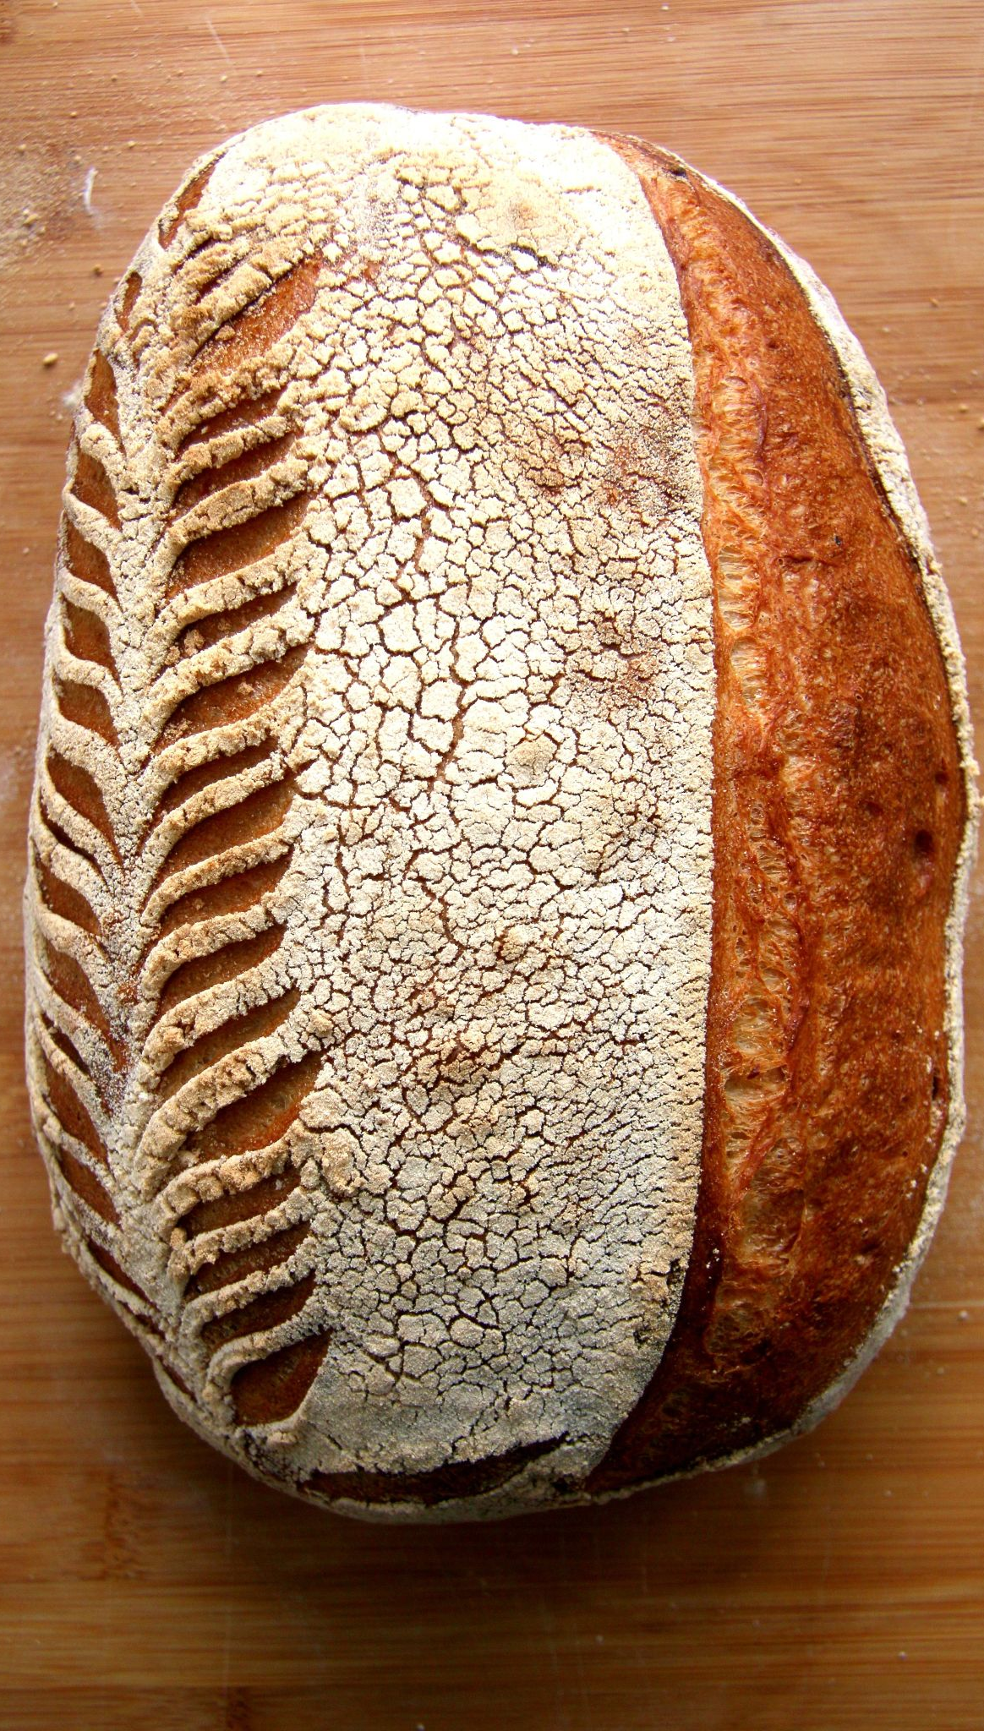
Image Credits
Bread on Wooden Background by Ales Krivec on Pexels
Flatlay of Breads by Mariana Kurnyk on Pexels
Person Cooking Noodles by Prince Photos on Pexels
Glowing Embers in Close Up by Jan van Bizar on Pexels
Wheat Field Under Gray Sky by Pixabay on Pexels
View of River in Meandering Uninhabited Valley by Urtemud.89 on Pexels
Dough and Hands by Nadya Spetnitskaya on Unsplash
Sliced Bread by Jude Infantini on Unsplash
Sourdough Bread Loaf by Tommaso Urli on Unsplash
Presentation template by SlidesCarnival

Slide 31
Thank you!
Questions?
LOEX
2023
Notes:
This presentation (view only): https://tinyurl.com/loextour
Padlet: https://tinyurl.com/loexserved
PollEverywhere live presentation link:
https://www.polleverywhere.com/multiple_choice_polls/zgUVMxnuYn6CQYb92KhOg?preview=true&controls=none
PollEverywhere submit response: https://tinyurl.com/loextourpoll
Log in to LibApps: unm.libapps.com
Image by Ales Krivec on Unsplash

