Slide 1
PRESENTING RESEARCH AS CURIOSITY THROUGH VISUAL THINKING STRATEGIES (VTS)
KAYLA BIRT FLEGAL
DEPAUW UNIVERSITY LIBRARIES
ALEXANDRA CHAMBERLAIN
(IN ABSENTIA)
ASSOCIATION OF ACADEMIC MUSEUMS & GALLERIES
Notes:
My Name
Alexandra with AAMG
-- Alex & Ashleigh Coren
- Take breaks as you need!
- Choose to engage, lean in.
Impetus for collaboration--
Seeing similarities between students coming to art exhibits/interacting and students in the library (GETTING STUDENTS CURIOUS)
Combining VTS with ACRLs Framework, particularly the frames
-Research as Inquiry
-Scholarship as Conversation
To make sure I best use our time together, let's jump in.

Slide 2
Session Outline
Pre-Survey (2 mins)
VTS Session (15-20 mins)
Post-Survey (2 mins)
Deeper look at VTS (5-8 mins)
Best practices for VTS in library instruction (5-8 mins)
Dream and discuss (10 mins)
RESEARCH AS CURIOSITY THROUGH VTS
LOEX 2023
Notes:
Outline for today's session:
1. Pre-survey
2. VTS Session
- individual/think/write
- Share out as group
3. Post-survey
4. Deeper look at VTS
5. Best practices
6. Dream and discuss how you could apply VTS in your instruction

Slide 3
Session Outcomes
01.
Participate in a VTS session
02.
Introduction to Visual Thinking Strategies and its application to library instruction and research
03.
Assess your own curiosity and confidence by completing a pre- and post-survey
04.
Brainstorm, experiment, and dream about possible applications and partnerships on your campus
RESEARCH AS CURIOSITY THROUGH VTS
LOEX 2023
Notes:
1. Participate in a VTS session
2. That you have a general introduction to VTS and its potential applications to libraries and research
3. You're able to assess whether or not the pedagogy stretched your own curiosity/confidence/engagement via the pre/post survey
4. Talk and discuss how you could apply this pedagogy via strategic partnerships on your campus and encourage students to come to their research projects with a little more agency and confidence.

Slide 4
Pre-Survey
RESEARCH AS CURIOSITY THROUGH VTS
LOEX 2023
Notes:
for the Pre-survey
Take yourself back to your undergraduate days. This is who this survey was written for-- in particular students who self-identified to enroll in a study skills class ("how to college").
Don't overthink!
I'll give you about 2 mins.
Okay. Now let's take a look at some art!

Slide 5
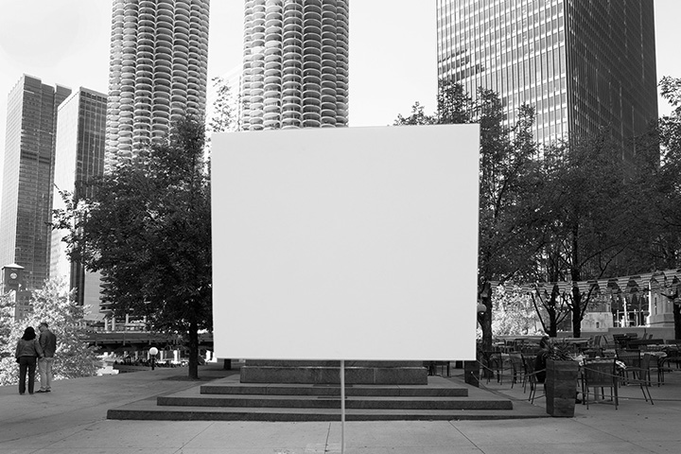
Notes:
(15-20 mins)
2 minutes: just look.
If you need to get up to get closer, different view, please do so!
........
Pull out a piece of paper or, since I trust you won't get too distracted on your computers, you can pull up a blank doc.
1. What's going on in this picture?
2. What do you see that makes you say that?
3. What more can we find?
Let's DISCUSS!

Slide 6
Post-Survey
RESEARCH AS CURIOSITY THROUGH VTS
LOEX 2023
Notes:
Kelly Kristin Jones
Dodging Tool #5, 2018, Piezographic print, dimensions vary
Survey design:
based off of a survey from Carnegie Mellon-- assessing research, writing, and art (related to VTS)
You should have your answers sent to you via email.
Students completed these surveys on different days, so this is not an exact replica.
What this did allow us to see was the students' perceptions of themselves from point A in the semester to point B.

Slide 7
Qualitative Student Feedback
“I learned to be confident in my thoughts and voice them even if it might be wrong. I learned to leave no stone unturned. Everything is important while reading and everything can hold a purpose. Lastly, I learned that outlining your questions is very helpful while trying to decipher a story….This exercise showed me that you aren’t expected to hit the nail on the head with every thought...and that it’s okay, your thoughts will lead somewhere.”
RESEARCH AS CURIOSITY THROUGH VTS
LOEX 2023
Notes:
I gathered feedback on the sessions via the students' journals:
“I learned to be confident in my thoughts and voice them even if it might be wrong. I learned to leave no stone unturned. Everything is important while reading and everything can hold a purpose. Lastly, I learned that outlining your questions is very helpful while trying to decipher a story….This exercise showed me that you aren’t expected to hit the nail on the head with every thought...and that it’s okay, your thoughts will lead somewhere.”

Slide 8
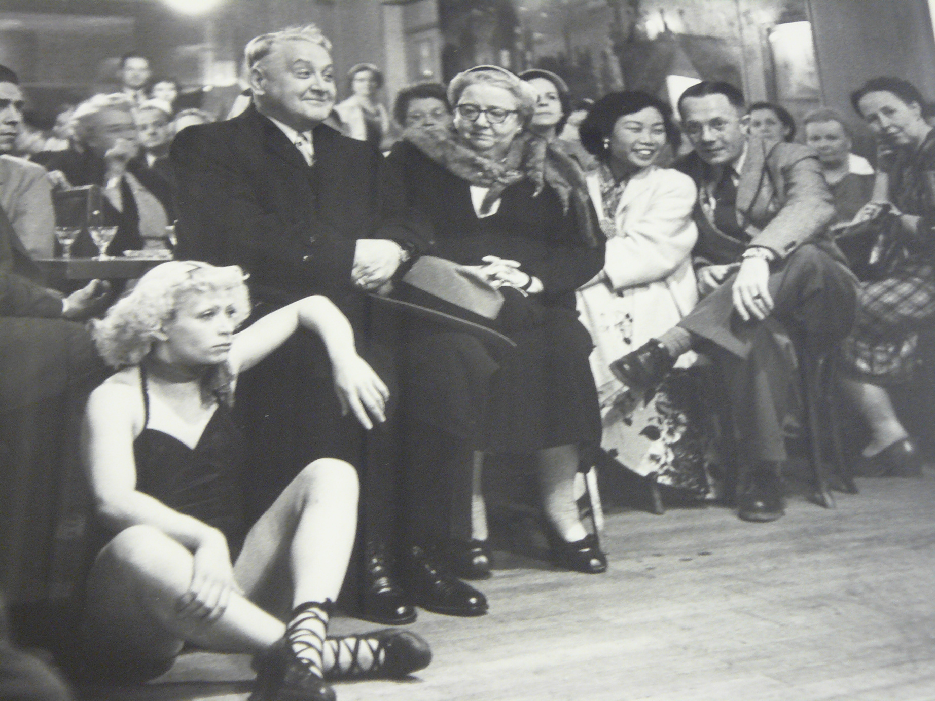
RESEARCH AS CURIOSITY THROUGH VTS
LOEX 2023
Notes:
Robert Doisneau
Le Petit Balcon
1953, 1982.12.8
18-1/4(H) x 22-1/8(W)
Silver Gelatin
“I didn’t think we had to remove our backpacks and coats, but leaving them almost gave me relief. I feel that I always have my backpack and coat either on me or next to me. Not using or being around these two items in a way made me feel liberated. When we went inside the room and looked at the photo, the woman/performer on the floor was the first thing that caught my attention. I kept reflecting and questioning as to why she caught my attention. Was it because of the lighting? Because she was right in front of the picture? I altruistically believe that the performer caught my attention first because I saw myself in her. No matter how much work the performer could have put in, she still seemed that she was struggling. I think the process of reflecting on the photo made me realize the importance of just looking.
.......

Slide 9
"While our class had different interpretations on the photo, there was no right or wrong answer. In fact, each of our answers had value in them. Additionally, doing the process of VTS made me realize that each of us learn in different ways.”
Spring 2019
RESEARCH AS CURIOSITY THROUGH VTS
LOEX 2023
Notes:
......
"While our class had different interpretations on the photo, there was no right or wrong answer. In fact, each of our answers had value in them. Additionally, doing the process of VTS made me realize that each of us learn in different ways.”

Slide 10
Visual Thinking Strategies
Yenawine & Housen
Student-centered discussion
An art educator (Yenawine) and a cognitive psychologist (Housen) created the pedagogy originally for K-12 students
Value student perspective and voice
Encourage further inquiry
Have students provide evidence that encourages critique
RESEARCH AS CURIOSITY THROUGH VTS
LOEX 2023
Notes:
VTS is a research-based teaching method focusing on a teacher-facilitated discussion surrounding carefully selected images for a student-centered discussion discovery process to take place. Created by Philip Yenawine and Abigail Housen.
VTS draws its theoretical underpinnings from cognitive developmental psychology, most notably Vygotsky with his emphasis on speech as a precursor to thought.
“During VTS lessons:
- All students must have ample opportunity to point out what they see in the art they examine and express their opinions about it;
- Student must know that their thoughts are heard, understood, and valued;
- Student must provide evidence to explain their interpretive comments; and
- Student must see that each comment contributes to the group process of mining the art of multiple meanings.”
“The curriculum works best if you follow certain basic, logical, rules:
-Ask the questions provided to initiate an active process of discovery and probing on the part of the students.
-Listen carefully to and acknowledge every answer by looking with the students at the image, pointing to those details mentioned, and paraphrasing what students say.
-Facilitate the discussion as it progresses, linking various converging and diverging opinions and helping students to synthesize a variety of viewpoints.
-Encourage further inquiry, keeping the process open-ended and asking students to stretch and search for information beyond what they know.”
Yenawine and Housen sought to empower even the youngest viewers to interpret artwork for themselves.

Slide 11
Connecting research to
Carefully selected images
ACRL Framework
What next? Continue the inquiry
Research as Inquiry
Scholarship as Conversation
RESEARCH AS CURIOSITY THROUGH VTS
LOEX 2023
Notes:
Sonja Hinrichsen
Big Circle (from Snow Drawings)
2009, 2009.11.1.5
21-3/16(H) x 25-15/16(W) (Framed)
Ink Jet Print
Best practices in the library:
Think of the role curiosity plays in scholarship-- it's the first words on a blank page!
1. Have someone who knows art help you find an image/artwork!
2. Recall the dispositions and practices of the frames Research as Inquiry and Scholarship as Conversation
- "appreciate that a question may appear to be simple but still disruptive and important to research"
- "demonstrate intellectual humility"
- "critically evaluate contributions made by others in participatory information environments"
- "recognize that scholarly conversations take place in various venues"
- "suspend judgment on the value of a particular piece of scholarship until the larger context for the scholarly conversation is better understood"
-Remind students about the importance of inquiry in research: in relation to search terms, making connections, and being in conversation with existing work.
***Empower students that they have a voice that is critical and valuable.
- "By the time they reach middle school, many students have already defined themselves in fixed terms according to their perceived reading and writing abilities. They have decided who is “good” at reading and comprehending text and who is not, and these self-designations can block their willingness to take risks (Dweck, 2006; Johnston, 2011). Yet students may experience it as a more open invitation when we invite them to tell us what they think is going on in a painting or sculpture, especially if it is an unfamiliar work."
3. We talk about research being iterative- it keeps going after the project/paper is ‘complete’-- VTS discussions mirror the iterative process: “letting students think they have ‘completed’ a discussion of a work of art is misleading. One of the wonderful aspects of art is the fact that it can be revisited many times productively…The best way a to end a class is to complement students on how well they probed a particular image, for example, or how carefully they listened to one another” (2009, p.8).

Slide 12
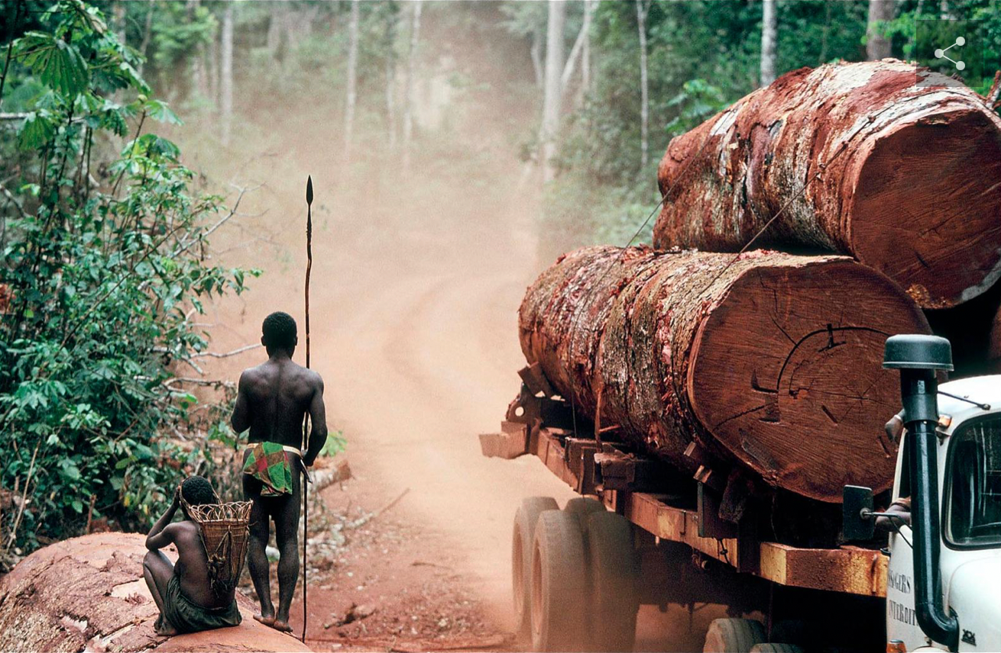
Notes:
Georges Merillon in the exhibition "Deforestation"
I presented this image to a class called "Mythbusting Tropical Nature".
I work at a predominantly white institution in the Midwest and the students struggled to know how to describe the two figures in the image. (we had LOTS of good conversation) What do I do as the moderator/leader in responding to their contributions matters.
Let's move on to best practices...

Slide 13
Best Practices
for the library
Maintain Relevance
Look beyond what is traditionally recognized as art
Handling difficult conversations with curiosity
RESEARCH AS CURIOSITY THROUGH VTS
LOEX 2023
Notes:
Ashleigh Coren this morning:
-You don't have to have empathy/you have to have understanding
-Facilitator, not the center.
- Maintain Relevance to students, their course, and your collaborator(s).
----Timing: 15-20 minutes, take your cue from the instructor or students
-----Facilitate connections between comments to help students see that the conversation is part of the research. Point out various terms that students are using that they could use in a database.
------Can incorporate a follow-up question at the end "what are three words you heard today that you could use in your research? What's a research question you have about the image?
- Look beyond "art"-- substitute "art" with "information" you can use VTS with other forms of information such as photographs, cell slides, etc.
- You will have students make questionable comments or problematic statements*** ESPECIALLY if you are using certain art/images/data (LOOK TO YENAWINE).
-----Paraphrase each person's response "what I hear you saying is..." (this take practice)
----Remain open: consider all possibilities and attempt neutrality to the comments unless warranted to shift. Right and wrong interpretations are not issues at this point. When a student says something hurtful (or challenging or silly) use your common sense to determine how to handle AND consider that telling the student they are wrong rarely achieves its goal. Take the hurtful comment/word/phrase and reframe in your paraphrase: "those people are poor." to "they don't appear to live in a society that values the same things we do." Then move on to "what else can we find?" We want students to be open and remain open to other ideas and more interesting ways to think.
How do you translate this to your institution? What does this mean for you at your library?
Where I first saw the opportunity for VTS in library instruction was its emphasis on creative inquiry-- students often come to the Research Desk or instruction sessions with an idea that research is fixed- and sometimes we teach it that way! (click here, do this, search here, these words, etc.). What VTS allows students to do is enter the research conversation with their own ideas (creating buy-in and establishing authority) and explore those ideas freely (creativity of search terms, unpredictability of where research can take you). VTS encourages students to find AND SHARE their observations and can VALIDATE their authority in the process. There is potential for VTS beyond the Art Department- think of the possibilities with other disciplines that could use images, or can be an artistic graphical representation of data! And lead students through that process of finding their own questions, sharing those, and growing from that interaction.

Slide 14
Let's dream.
What are advantageous partnerships at your campus to incorporate VTS?
Kelly Kristin Jones
Untitled (David), 2022, Archival pigment print framed in walnut, 33in x 27in, Edition of 3
RESEARCH AS CURIOSITY THROUGH VTS
LOEX 2023
Notes:
Think beyond the Art Department!
A few other collabs/instruction sessions where I've used VTS:
- FYSs
- History and the environment
- Sustainability course
- Study skills course
- Upper-level composition course
Lots of scholarship on how it's been used in the veterinarian field, and VTS and discussing racial trauma/generational trauma (Gardner, 2017).
Where can you start immediately? Right now?
Begin at the end...

Slide 15
QUESTIONS?
Our VTS LibGuide
LIBGUIDES.DEPAUW.EDU/VTS
KAYLABIRT@DEPAUW.EDU
RESEARCH AS CURIOSITY THROUGH VTS
LOEX 2023

