Slide 1
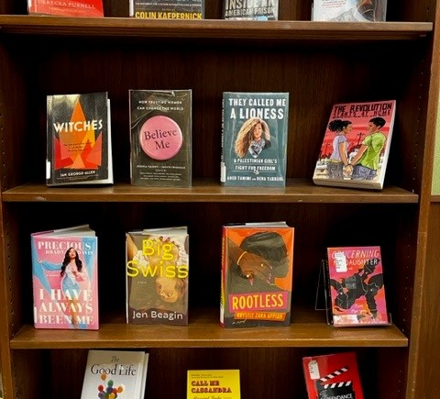
Students Shape the Shelves
Student-Led Collection Development for Diversifying Collections and Making Connections
Kate Blinn
Jennifer Coval
Laura Surtees

Slide 2
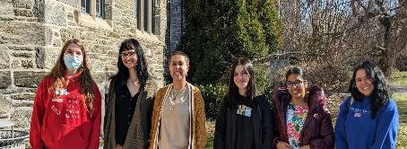
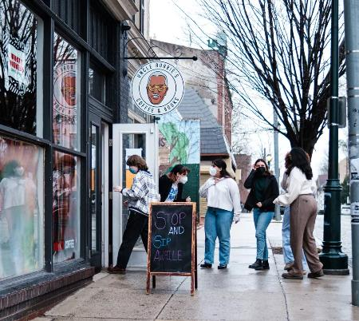
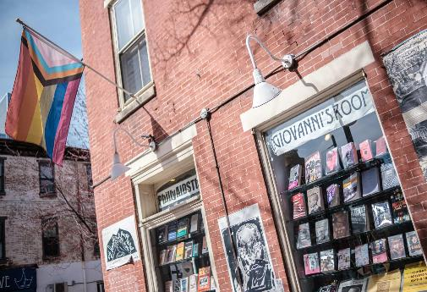
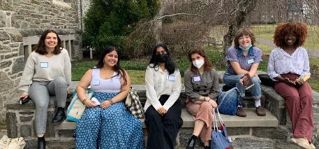
The What: Program Overview
Goal: promote diversity in the library collections
by providing students with the knowledge and a budget
to purchase popular reading material
from independent bookstores whose collections reflect diverse voices.
Two independent bookstores with a focus
Budget
$5000 for books, student wages, and incidentals
Participants
2023 Cohort
Uncle Bobbie's Coffee and Books
Philly AIDS Thrift at Giovanni's Room
2022 Cohort

Slide 3
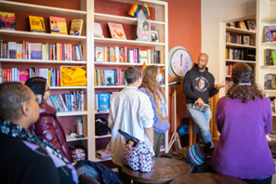
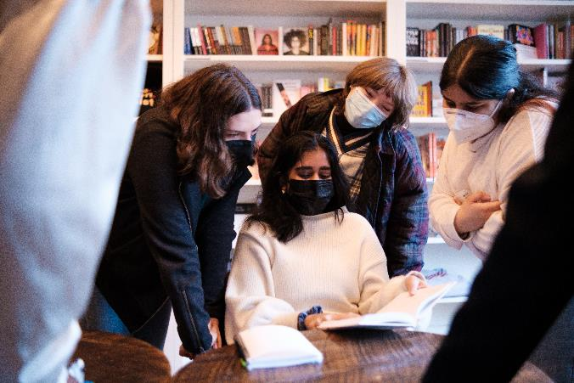
Library:
The Why: Goals
DEIAR goals
Bring more student voices into the library's collections
Support local independent bookstores
Student:
Understand the selection and acquisition process in libraries and bookstores
Engage with the library collections

Slide 4
The How: Program Development
Given the goals, our simple idea:
A week-long paid program that lets students choose new titles for our pleasure reading collection.
How do we create a curriculum to support and structure the week?
We should teach students about collection development in different contexts – academic and public libraries
Use our process as a model

Slide 5
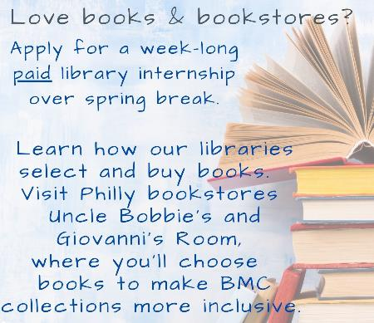
The How: Program development
Where should we buy the books?
We should visit and create relationships with independent bookstores that curate collections for their communities
What types of books should they choose?
Students should select books that reflect their interests and their identities.
What should we call the program, and how should we market it?
Students Shape the Shelves (formerly Connecting Collections and Communities)

Slide 6
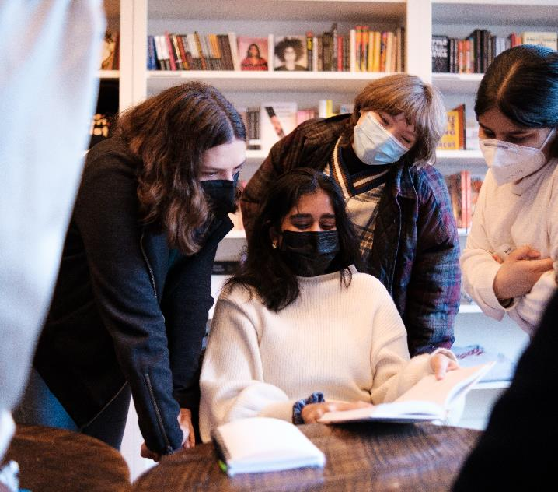
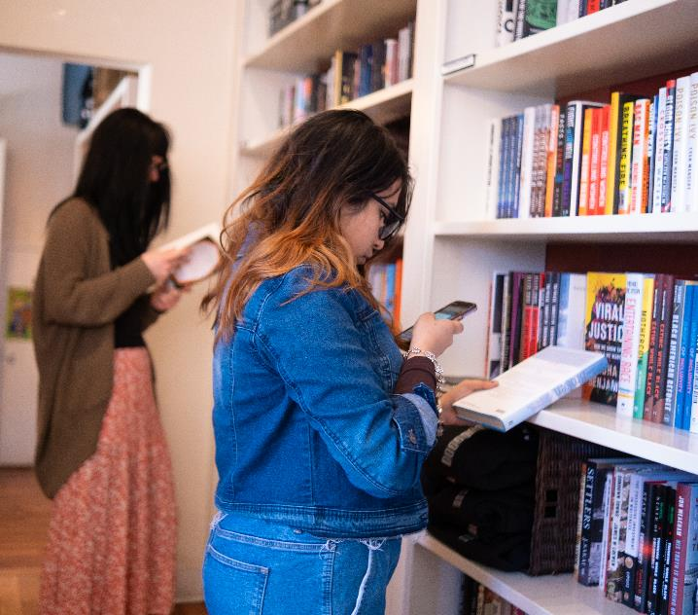
The Who: the students

Slide 7
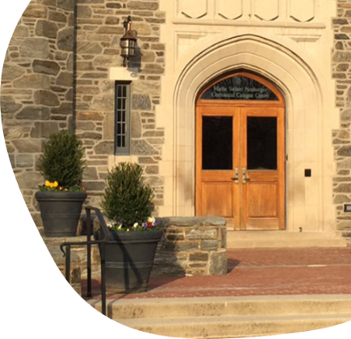
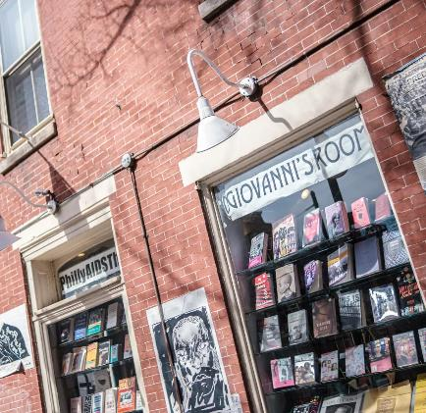
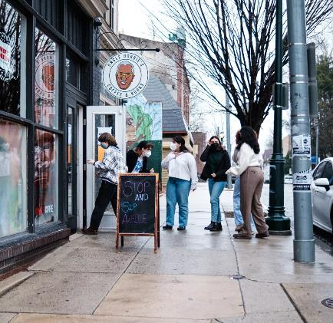
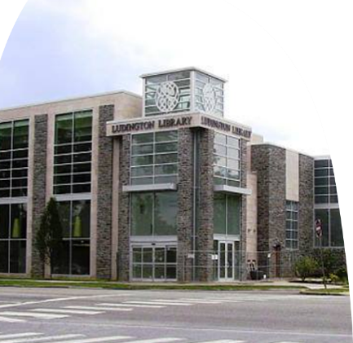
The Where
Places we visited:
Bryn Mawr College Bookshop
Philly AIDS Thrift at Giovanni's Room
Uncle Bobbie's Coffee & Books
Ludington Public Library

Slide 8
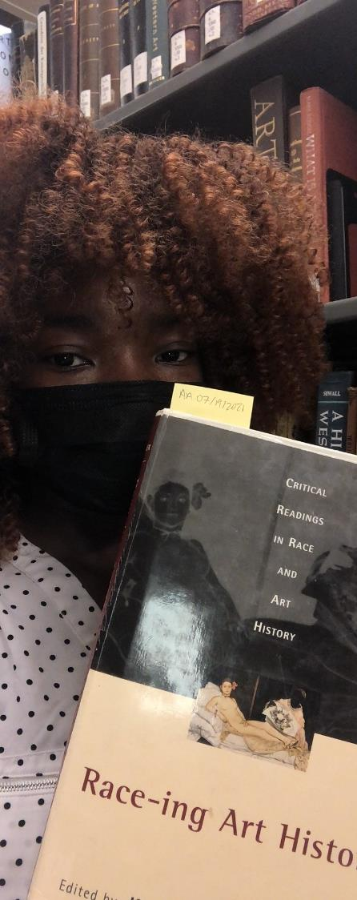
Students Shape the Shelves: Program Highlights
Visits:
Bookstores, college bookshop, & public library
Collections-focused tours of campus libraries
Student collection process:
Discuss academic library acquisitions & collection development
Review and discuss selections; agree on final purchases within a budget
Library buys student selections from the bookstores
Shareable outcomes:
Students create online presentation with reflections & reviews
Public celebration and display of new titles

Slide 9
The When: The week's programming
Mon.
Tues.
Weds.
Thurs.
Fri.
BMC Bookshop
Tour campus libraries including Tech Services
Discuss readings
Shop at 1st bookstore, record possible titles in iCollect Books app.
Reflection/writing time
Public Library
Shop at 2nd bookstore
Special Collections
How selectors at BMC choose books
Gather data about book selections
Student collection development meeting
Making connections and reflections
Celebration
Big picture thinking about collections
Acquisitions process & lifecycle of a book

Slide 10
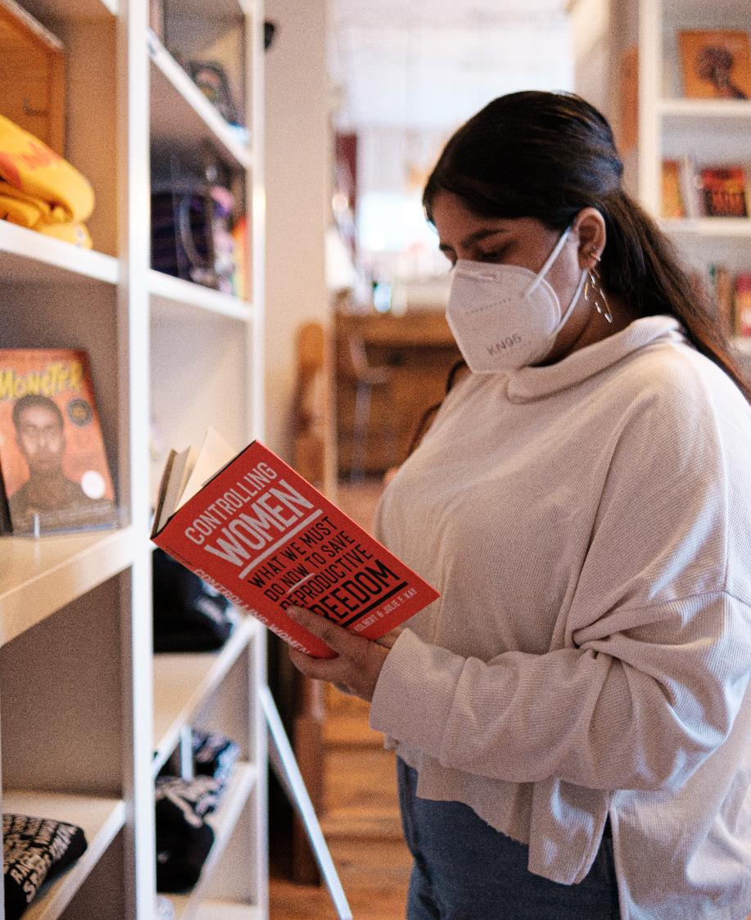
Student Outcomes, in their own words
Before this internship, I did not realize that there is an immense amount of time, labor, and care necessary for a book to arrive on a shelf and, eventually, into my hands.

Slide 11
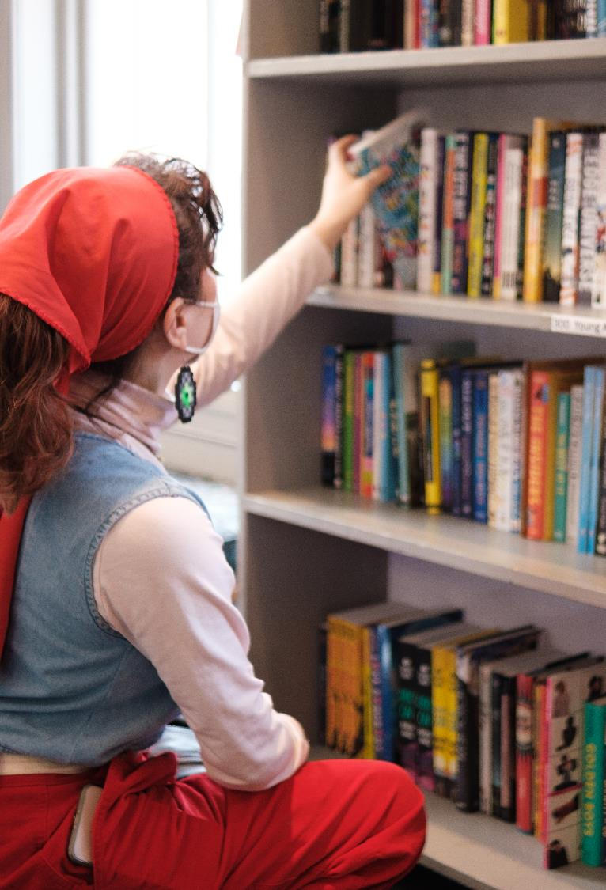
Student Outcomes, in their own words
Your dollar signifies your priorities. Spending money at large corporations like Amazon takes away resources from small, independent bookstores that have more consideration for reader experience.

Slide 12
Day 1: What role do libraries/bookstores play in connecting with or reflecting their communities?

Slide 13
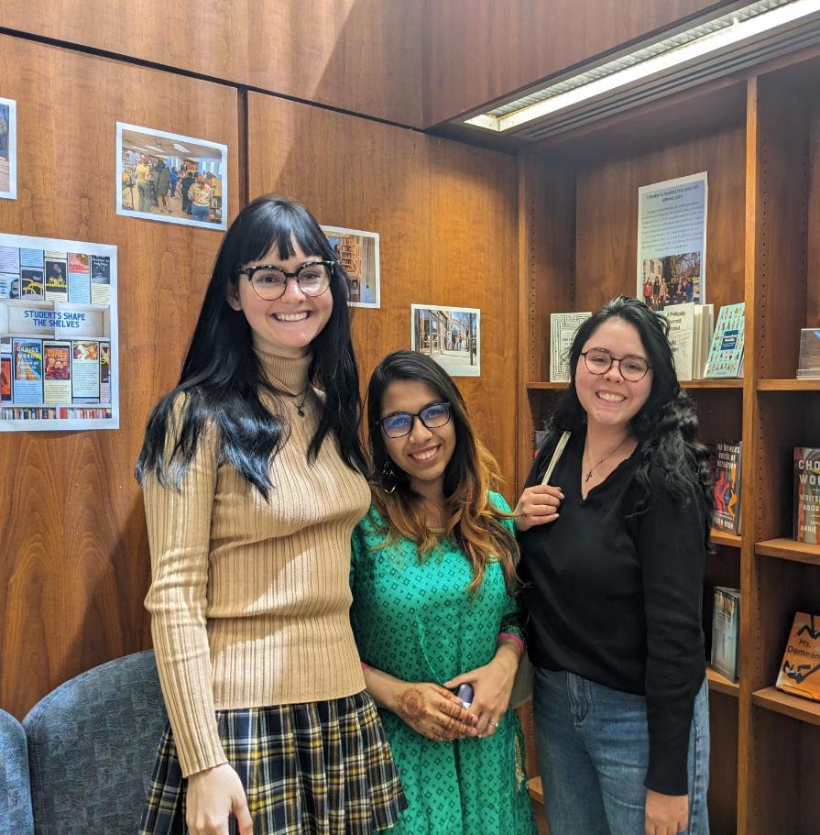
Student Outcomes, in their own words
It was so cool getting to learn about how these spaces [bookstores and libraries] function within their communities -- not just as libraries and bookstores, but also as important gathering spaces for people to come together and communicate in a variety of different ways.
I hope the things that we’ve learned and worked on help the Bryn Mawr community feel more in touch with their libraries, and that our work to diversify the collections makes it easier for every student to find a book that resonates with them.

Slide 14
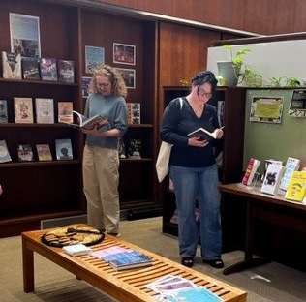
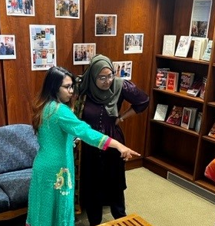
Benefits to Library
Add books that represent diverse voices and experiences
Bring more student voices into the library’s collections
100+ student selected books purchased each year
38% of 2022 titles checked out at least once
A valuable form of outreach as students became ambassadors for the library

Slide 15
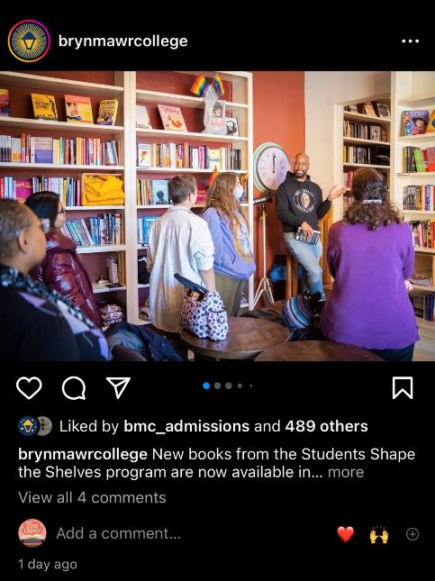
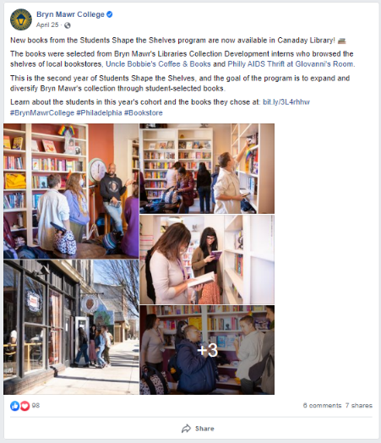
What We Learned, Unexpected outcomes
Create and continue relationships that support local independent bookstores
300+ firm order books purchased from independent bookstores since 2022
New ways of working across Research and Acquisition library departments
Creation of & sharing replicable model

Slide 17
Reflections and Insights
What parts of the program might work well in your library?
What might you change to fit your local context? Does your library interact with other bookstores and how?
What would you tell students about how you prioritize and make decisions related to collections?

Slide 18
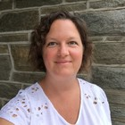
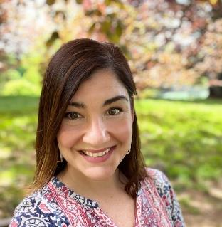
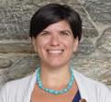
Thank you!
Be in touch! Library@BrynMawr.edu
Kate Blinn, Social Sciences & Data Librarian
Jennifer Coval, Student Success Librarian
Laura Surtees, Research & Instruction Librarian

Slide 19
The When: Preparation to Party
November | Reach out to partners
December | Update flyer and website
January | Advertise, Info session
February | Applications due (early Feb.)
March | Internship! Debrief
April | Celebration when books arrive

