Slide 1
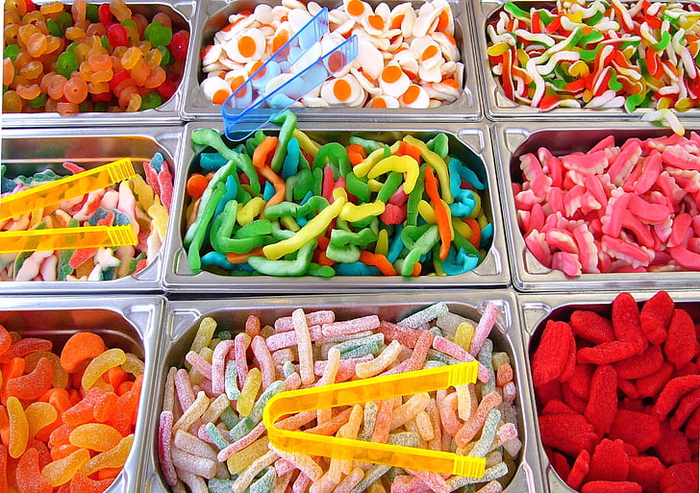
Yes You Candy!
Empowering Students
on Academic Suspension through
Differentiated Instruction
Notes:
https://www.hippopx.com/en/pick-and-mix-children-s-sweets-candy-colorful-treat-confectionery-food-93457

Slide 2
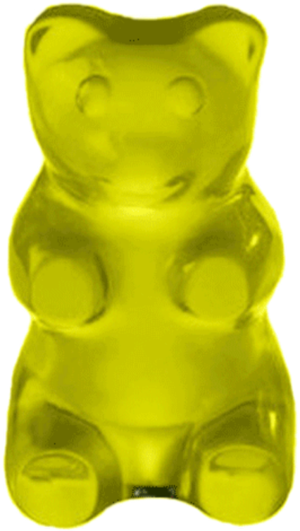
Andrea Parton
Discovery & Access Librarian andrea.parton@uafs.edu
Jason Byrd
Director of Library Services
jason.byrd@uafs.edu
Sierra Laddusaw
Scholarly Communication Librarian sierra.laddusaw@uafs.edu
Notes:
https://www.pngkey.com/download/u2q8a9q8r5t4r5i1_blue-gummy-bear-gummy-bear-white-background/
https://www.pngfind.com/mpng/oTommb_png-and-bear-image-gummy-bear-white-background/
https://www.pngfind.com/mpng/JmhmxJ_gummybear-sticker-gummy-bear-white-background-hd-png/

Slide 3
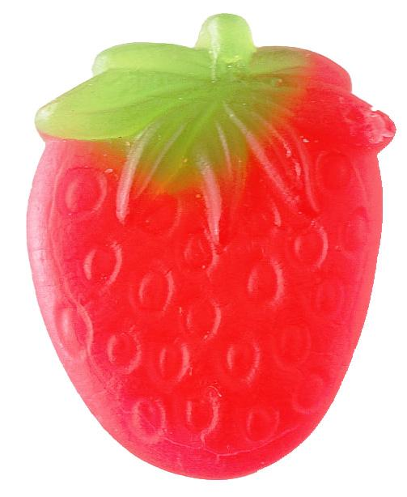
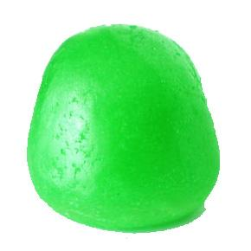
List of Ingredients
Welcome to our Candy Store: Academic Librarians and Student Success
It’s a Mixed Bag: Understanding Differentiated Instruction
Confectioners: Overview of the SAS 0201 curriculum, assignments, and assessments
Good and Plenty: Preliminary results and feedback
Now and Later: Reflections on future course adjustments
Notes:
https://www.hippopx.com/en/strawberry-fruit-red-green-candy-429031 edited to remove background
https://www.hippopx.com/en/candy-ball-green-498656 edited to remove background

Slide 4
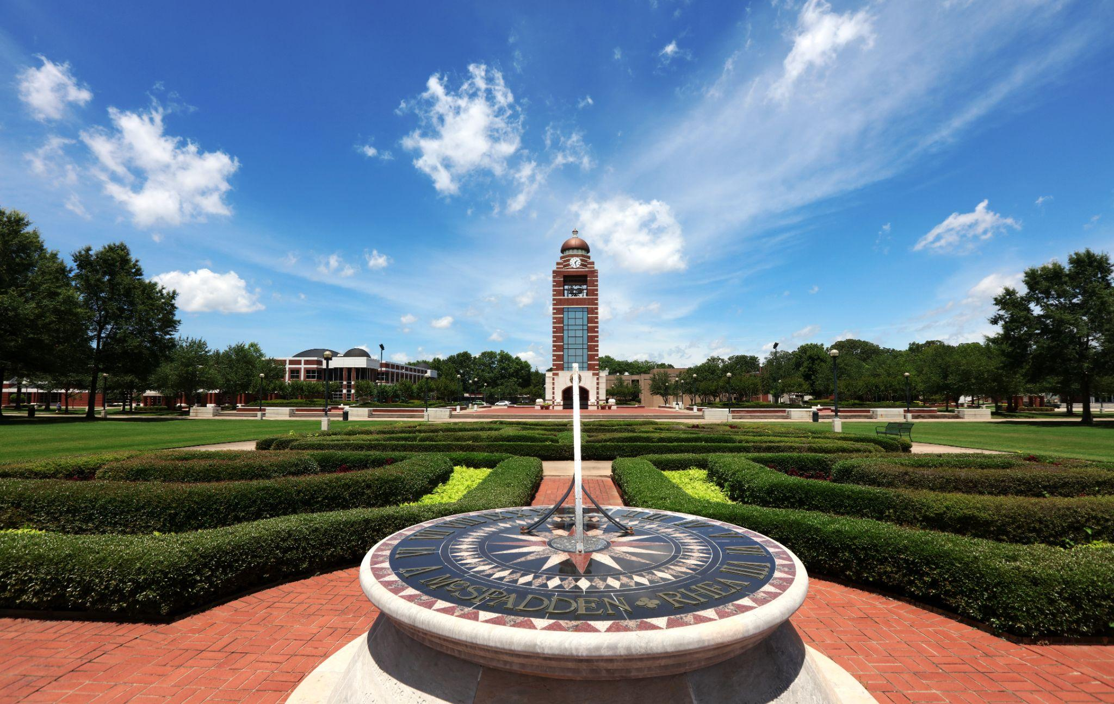
Notes:
First, a little institutional context:
A regional public university The University of Arkansas Fort Smith - colloquially known as UAFS - founded 1928 as Fort Smith Junior College.
After a series of name changes and growth, joined the University of Arkansas System in 2003 and became a baccalaureate granting institution.
Around 4000 FTE, offering AA, Bachelors, and a couple of Masters Degrees.
We are not an open admissions university, but we’re pretty close. Most of our students are from the Fort Smith Metro area, encompassing western, but not northwestern, arkansas and eastern oklahoma.
We are located on the AR-OK Border, roughlgy equidistant to KCMO, Dallas, OKC, and Memphis

Slide 5
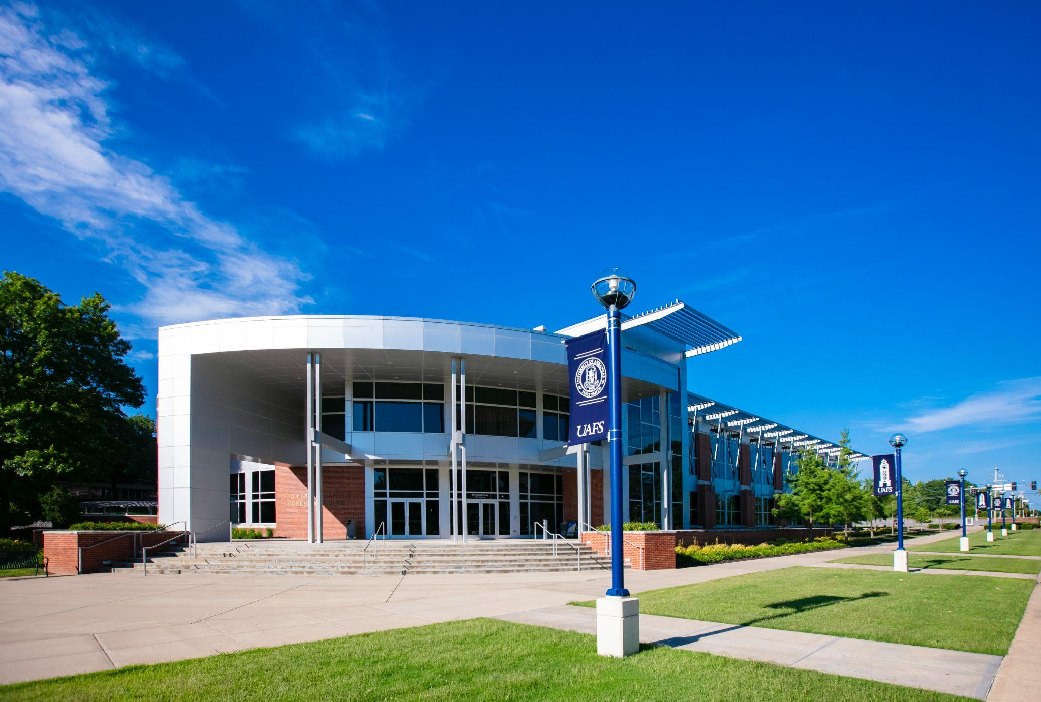
Notes:
Boreham Library, recent addition completed in 2013. This is our candy shop.
Relatively small operation - a director, plus five faculty librarians, and four staff members.

Slide 6
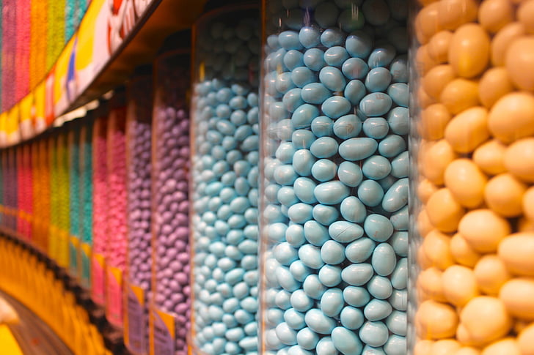
Welcome to our Candy Store: Academic Librarians and Student Success
Notes:
https://www.hippopx.com/en/candy-candy-store-chocolate-m-ms-sweet-lollies-store-346304

Slide 7
Student Success Impact
Library usage and GPA Studies
Credit-bearing information literacy courses
Disciplinary courses as adjuncts
Pivot from information literacy instruction to supporting learning.
Pedagogical knowledge
IL teaching
Faculty roles
Notes:
https://www.hippopx.com/en/fruit-jelly-candy-sweet-heart-candy-glass-sugar-calories-74532 but cropped
“This study shows a correlation but not necessarily a cause-and-effect relationship between library use and grade point averages for both graduate and undergraduate students.

Slide 8
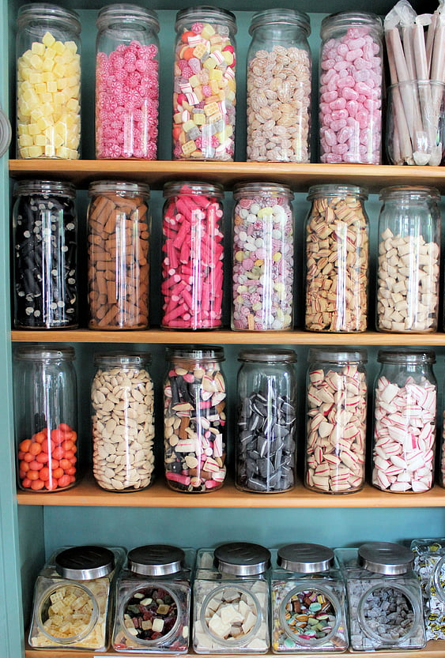
Project Origins
Higher Learning Commission Quality Initiative Program
Improve retention and persistence
Conditionally admitted students
First year experience
Academic Probation/Suspension
SAS 0201 - Bridges to Success Seminar
How do we enhance this course to be meaningful and relevant for our students?
Transition from staff to faculty status for librarians
Notes:
https://www.hippopx.com/en/candy-candy-store-candy-bottles-jars-sweets-colorful-468853 cropped
This project begins with discussions about improving retention and persistence among UAFS students, highlighting this three-pronged approach.
For students on academic suspension, meaning their cumulative GPA falls below 2.0 AND their semester GPA is also below 2.0, two options - sit out a semester, or take a lower course load and the 1 credit SAS 0201.
no one wanted to teach this course, no one wanted to work with these students - we inherited a course that was subpar -
“Based on their value in providing relevant information services in support of teaching, learning and research, academic libraries are pivotal to quality higher education by serving as a formidable support structure for at-risk students. Hence, as advocates of the 4IR, academic libraries will need to identify current challenges of at-risk students in the digital context and determine newer transformative programmes to help combat drop-out rates in HEIs.” (Lawal, 2021, p. 10)

Slide 9
It’s a Mixed Bag:
Understanding Differentiated Instruction

Slide 10
Poor Academic Performance
Socio-economic pressures
Mental health challenges
Inadequate K-12 preparation
Single-parent
Housing/food insecurity
Lack of motivation
Lack of focus
Notes:
https://www.hippopx.com/en/candy-hand-made-sweets-treat-confectionery-sucking-candies-colorful-color-390801
But cropped

Slide 11
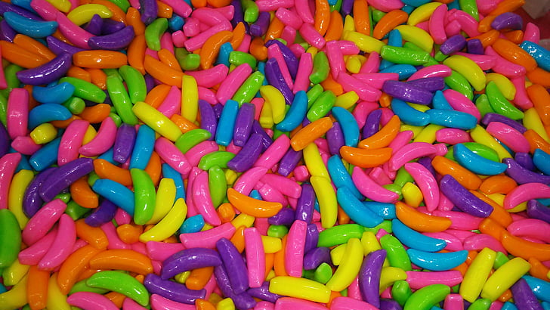
Differentiated Instruction
Center individual learners’ needs
“Teach with individuals and content in mind.”
Moving away from one-size fits all.
Tasks are tailored to individual needs, but learning outcomes remain the same.
Notes:
https://www.hippopx.com/en/candy-colors-parties-alegre-sweet-89270
“Targeted orientation programs that offer personalized attention can help at-risk students make early and meaningful connections with faculty and staff that have been shown to have positive correlations with student success.”

Slide 12
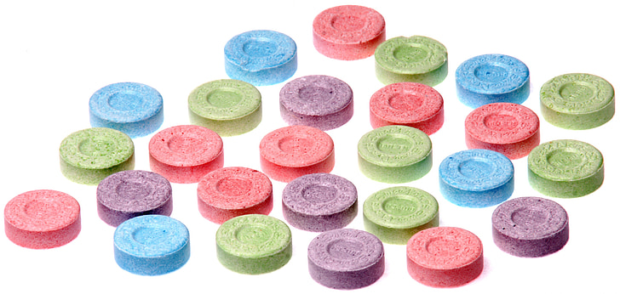
Confectioners:
Overview of the SAS 0201
Curriculum, Assignments, and Assessments
Notes:
https://www.hippopx.com/en/candy-sugar-sweet-unhealthy-food-diet-delicious-182124

Slide 13
It Wasn’t To Our Taste
Disorganized syllabus
Condescending learning outcomes
Generic assignments

Slide 15
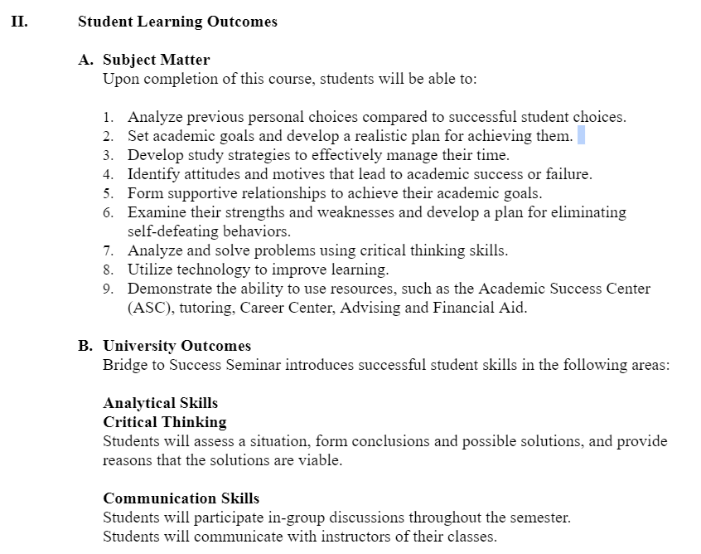
Notes:
“Also I didn’t write the Student Learning Outcomes.”

Slide 16
Stale Assignments
Blackboard discussion boards
Library scavenger hunt
“For how long can you check out a book?”
“Where is the 24 Hour Study Area?”
“Locate the current issue of Time Magazine. What is the cover story? (You may have to Google this.)”
“Where are the printers located?”
“Introduce yourself to a librarian. (Take a selfie for proof, if they are ok with this).”

Slide 17
Adjusting the Recipe
Created a stuctured syllabus
Learning outcomes are still in place*
Regular assessment
Created a “menu” of assignments
*a future goal is to address the Learning Outcomes
Notes:
https://www.hippopx.com/en/candy-sour-sugar-sweets-candies-colorful-134526

Slide 18
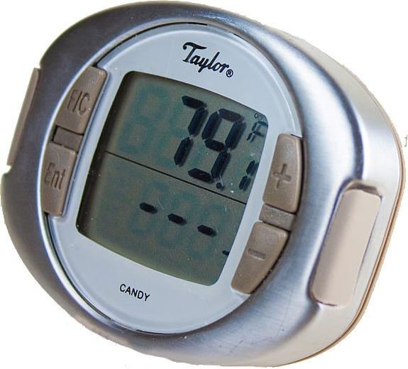
Measuring the Temperature
Self-Assessment
Goal setting
Reflections on tasks
One-on-one meetings
Final reflection paper

Slide 19
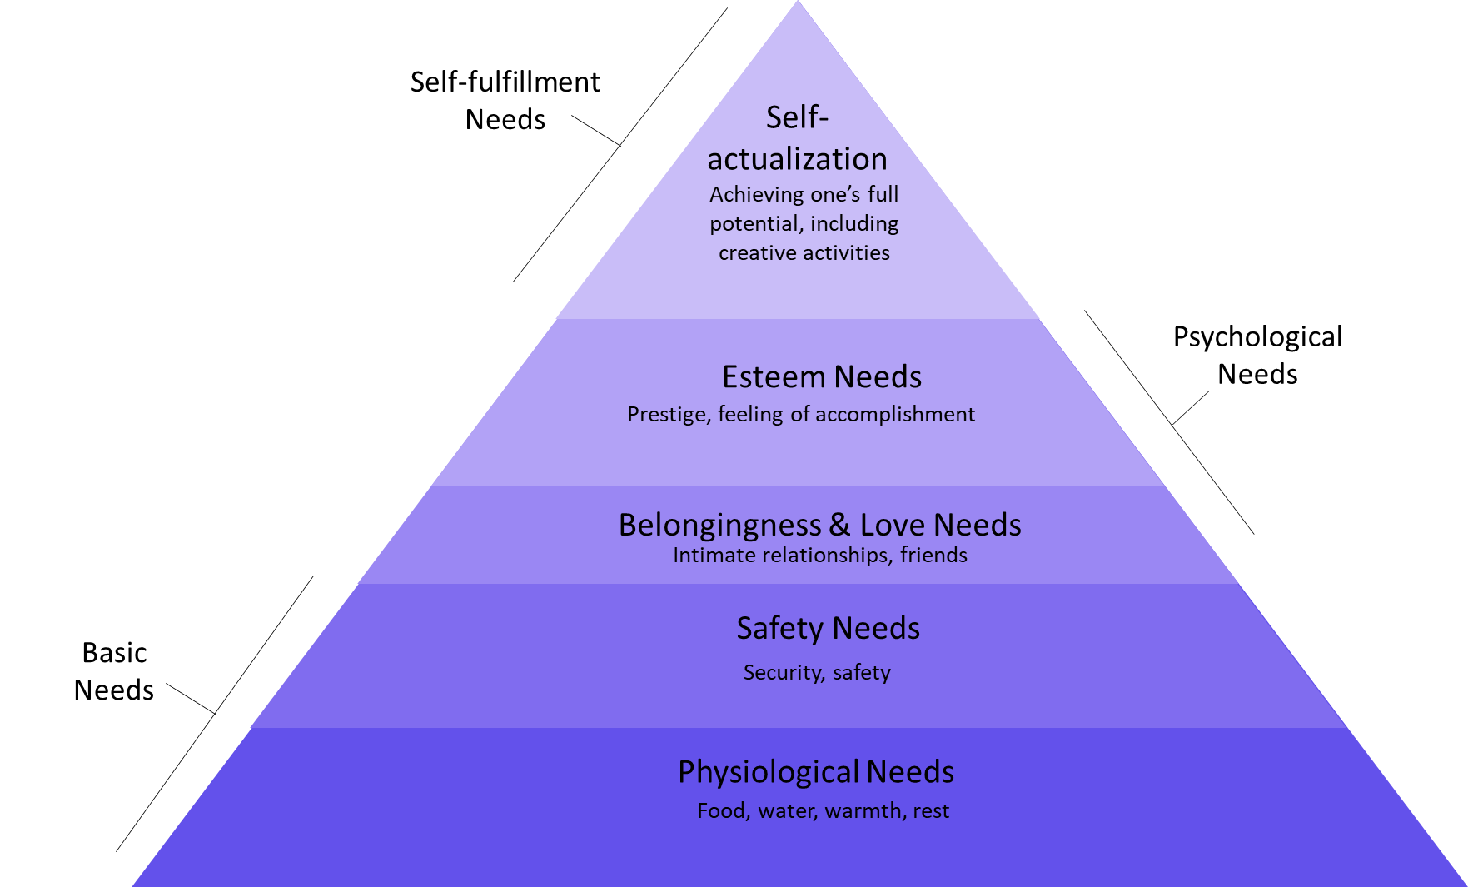

Slide 20
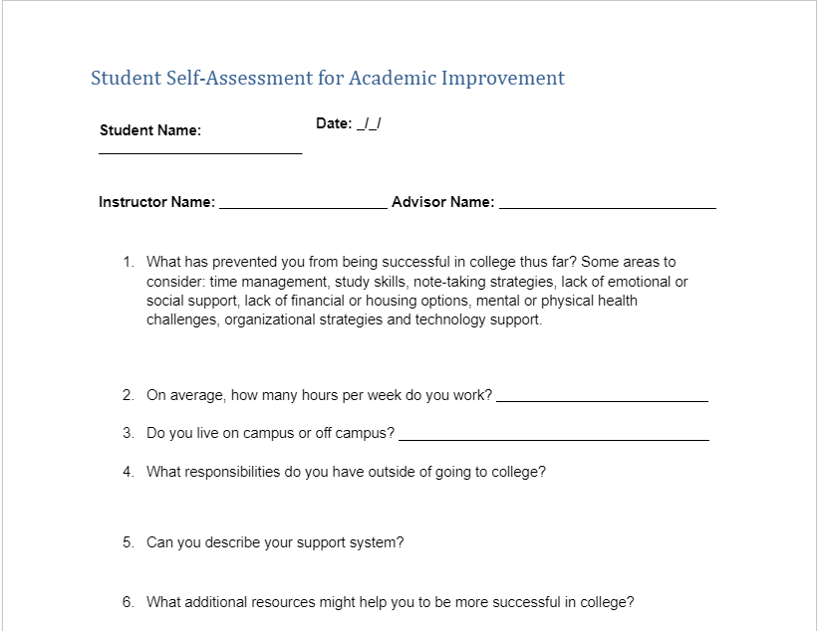
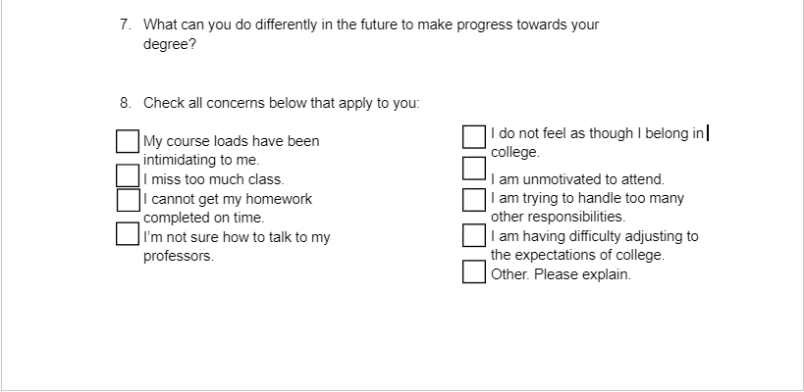

Slide 21
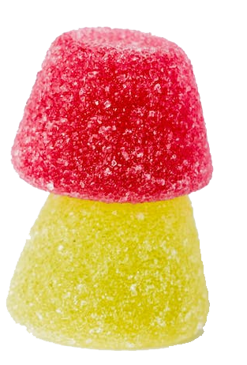
Tasks address academic achievement
Task, Experience, or Opportunity | Artifact to Submit | Reflection questions to answer
Implement a calendar system for time-management | Calendar for the week including school, family, work, and personal engagements | 1)What goal did this week’s menu item help you achieve? 2)How did it help you achieve that goal, or what did you learn or “take-away” from that experience? 3) How will you use what you learned going forward?
Meet with an Academic Coach to create a plan to enhance your study skills | Appointment Confirmation | 1)What goal did this week’s menu item help you achieve? 2)How did it help you achieve that goal, or what did you learn or “take-away” from that experience? 3) How will you use what you learned going forward?

Slide 22
Tasks address whole self
Task, Experience, or Opportunity | Artifact to Submit | Reflection questions to answer
Address mental health concerns with the Counseling Center | Appointment Confirmation | 1)What goal did this week’s menu item help you achieve? 2)How did it help you achieve that goal, or what did you learn or “take-away” from that experience? 3) How will you use what you learned going forward?
Connect with the Lion Pride Food Pantry and obtain food, if necessary. Also discuss the possibility of applying for EBT benefits – many full-time students qualify! | Reflection Only | 1)What goal did this week’s menu item help you achieve? 2)How did it help you achieve that goal, or what did you learn or “take-away” from that experience? 3) How will you use what you learned going forward?

Slide 23
Individual Sessions
What we ask:
What we do:
How is the student doing so far in the semester?
How is the student doing in their classes?
Does the student know what is coming up in their classes?
What did the student learned at their most recent assignment for SAS 0201?
What assignment is the student planning to accomplish next in SAS 0201?
Cheerleader vs. Coach
Celebrate their accomplishments
Hold them accountable
Connect the student to campus resources based on the conversations held and assignment reflections submitted
Some hand holding

Slide 24
Let’s “peep” at one student!
Self-Assessment Responses:
What has prevented you from being successful in college thus far?
“I was going through a lot of instability at home and it didn’t help with my mental health. I was diagnosed w/ anxiety, depression, CPTSD, and ADHD that I’ve been struggling with since childhood. I had a hard time being at school w/ my anxiety and pandemic and struggled w/ being comfortable and asking for help.”
On average, how many hours per week do you work?
“30-45 (planning to move to PT)”
What responsibilities do you have outside of going to college?
“My work responsibilities. Although not mandatory I pick up a lot of responsibilities taking care of and helping family, younger siblings, mother/grandmothers health. I do my house work and I’m also expected to help pay bills.”

Slide 25
Task Reflections
Time management:
Study Skills Workshop:
“Ive always had difficulty managing my time, prioritizing tasks, and remembering important info/ events. I feel like i fell compliment with my struggle and probably because of my ADHD refused to force myself to struggle in learning accountability with keeping track with myself and my tasks because it felt impossible. I already feel like the past week has been a bit easier to keep track of my things and even allow myself time to enjoy the things i want to do for fun which was always hard for me as well. I'm enjoying my time w school because I'm aware and i know whats going on and expected of me im pretty much ahead of a lot of my work in class, and im averaging As in my class. I didn't think this was doable last year it felt impossible like i was drowning and the more i struggled to breath the faster i sunk, but its because i wasn't implementing the right habits in a manageable and substanable way. I'm working on this this semester and i think a calendar to keep track of dates and tasks is vital way to implement positive time management skills.”
“I apologize for my tardiness i was under thought this assignment was due today i will be sure to keep more of an eye on it but i did do this assignment last week i hope its not too late to submit it. For this week i went to the suggested study workshop, although it was early i made an effort to go because I've struggled with studying for a long time. It's hard for me to focus and prioritizing. However, i am pretty good at retaining info when i understand it, its just focusing on what to understand and separating material is hard for me. Ive had a bad habit of focusing on what i already know and perfecting it rather working on what I'm not Proficient in because it makes me struggle and that frustrates me. However with what I've learned from the workshop I've been making an effort to study more frequently and see it as an opportunity on top of class to learn and understand. I even made the effort to form a study group since i learn better interacting with others about the material! I'm really excited about this semester and how i evolve!”

Slide 26
Final Reflection Paper Excerpts
“When I look back at last year and then reflect on this year I feel and think like a whole new person. Although I was dealing with a lot last year my mentality didn’t help me overcome those obstacles I was faced with. I didn’t know when to recognize that I needed help and how to ask for it. I was scared and unable to set boundaries with my work life balance and my home and family dynamic. I was dozing too much and didn't know how to juggle or cope with it so whatever i managed to actually do i did it without much depth. This year I took everything from a day to a week at a time. I gave myself realistic goals, and most importantly I changed my mentality into believing I could do it if I worked for it.”
“I knew college wasn’t going to be easy, but I never took the steps last year to make sure it wasn’t suffocating. This year I feel free and achieved and I’m proud of that. I've done a 360 when it comes to my mentality and it even helped dwindle down my mental health struggles I thought were impossible last year. I’m truly looking forward to keeping up with not just in college but in life. This year I’m going for what I want and I’m willing to work for it, and for once in a very long time in my life i can say I’m proud of myself.”

Slide 27
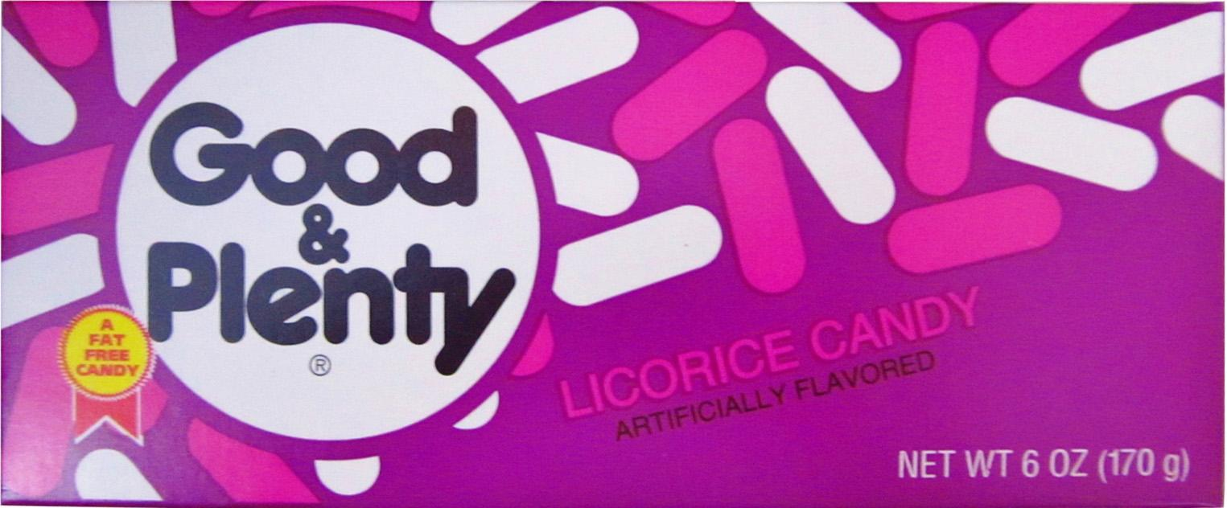
Good and Plenty:
Preliminary Results and Feedback

Slide 28
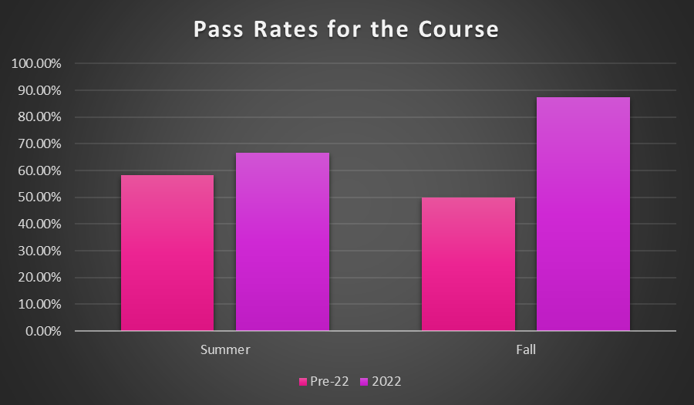
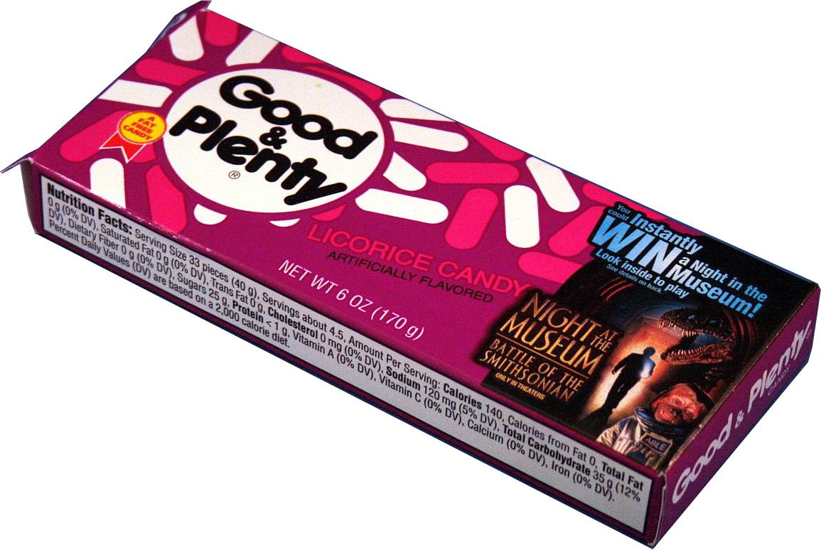
How did it turn out?

Slide 29
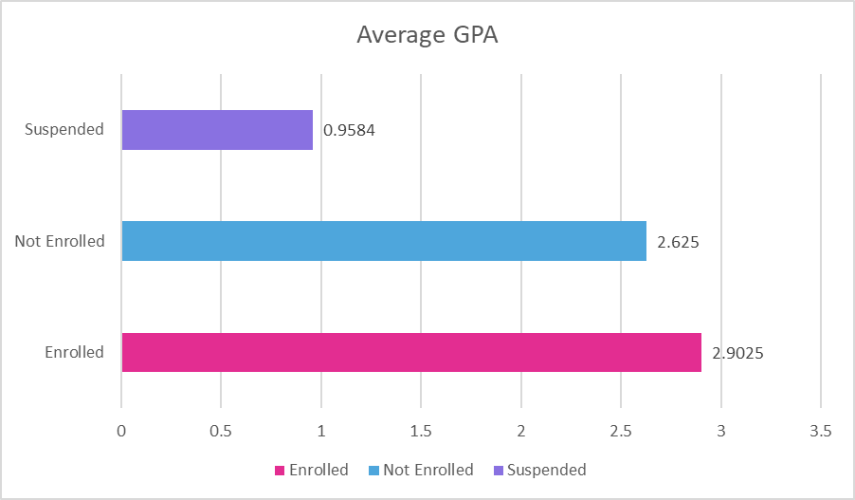
Consumer Reports

Slide 30
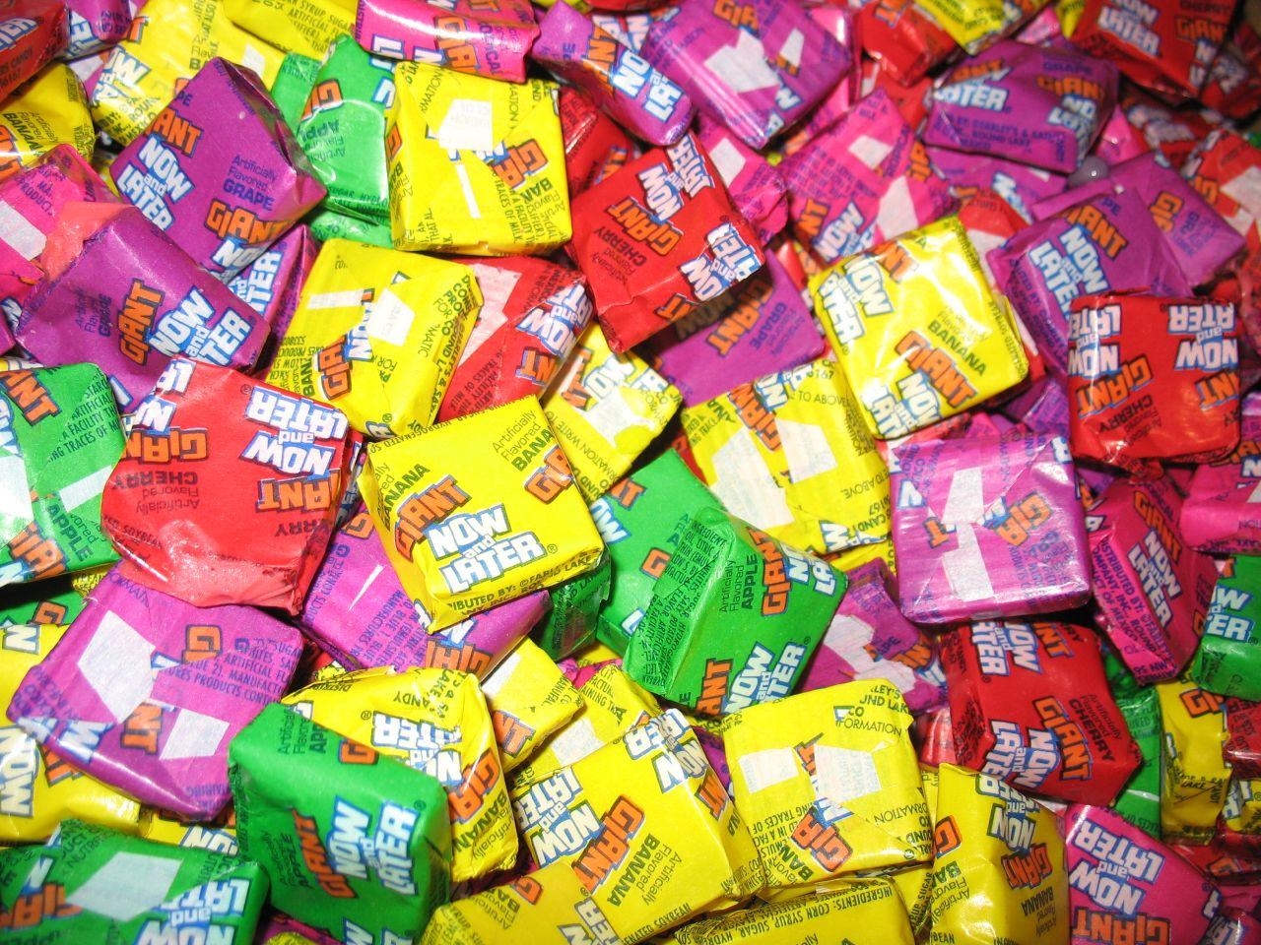
Now and Later: Adjusting Our Recipe

Slide 31
Now: Changes We’ve Made
Clarifications to and reorganization of course syllabus
Differentiated Instruction with weekly meetings
Invite students to select their own ingredients

Slide 32
Later: Future Modifications
Changing to 16-week course
Time Management Project Management
Rewriting Student Learning Outcomes
Adding various Tasks, Experiences, and Opportunities to our menu
Suggestions from the room?

Slide 33
References
Allison, D. (2015). Measuring the academic impact of libraries. Portal : Libraries and the Academy, 15(1), 30–40.
Barrett, L., Ghezzi, R., & Satterfield, J. (2015). Jay Gatsby goes to college: Engaging at-risk students. Reference & User Services Quarterly, 55(1), 11–17.
Cohen, N., Holdsworth, L., Prechtel, J. M., Newby, J., Mery, Y., Pfander, J., & Eagleson, L. (2016). A survey of information literacy credit courses in US academic libraries. Reference Services Review, 44(4), 564–582. https://doi.org/10.1108/RSR-03-2016-0021
Fleming-May, R. A., Mays, R., & Radom, R. (2015). “I never had to use the library in high school”: A library instruction program for at-risk students. Portal : Libraries and the Academy, 15(3), 433–456.
Ghaith, G. M., & Awada, G. M. (2022). Scaffolding understanding of scholarly educational research through teacher/student conferencing and differentiated instruction. Teaching & Learning Inquiry, 10.
Lawal, V. (2021). Transforming academic library services for at-risk students in the fourth industrial revolution: A literature review. Mousaion, 39(2), 1. https://doi.org/10.25159/2663-659X/8789
Lynn Bell. (2011). Faculty conversation: Carol Tomlinson on differentiation. University of Virginia School of Education and Human Development. https://education.virginia.edu/news-stories/faculty-conversation-carol-tomlinson-differentiation
Matamoros, A. B. (2016). Differentiated instruction in information literacy courses in urban universities: How flipping the classroom can transform a course and help reach all students. Urban Library Journal, 22(1), 1–28.
Mayer, J., & Bowles-Terry, M. (2013). Engagement and assessment in a credit-bearing information literacy course. Reference Services Review, 41(1), 62–79. https://doi.org/10.1108/00907321311300884
Sobel, K., Ramsey, P., & Jones, G. (2018). The professor-librarian: Academic librarians teaching credit-bearing courses. Public Services Quarterly, 14(1), 1–21. https://doi.org/10.1080/15228959.2017.1342584
Tomlinson, C.A., & McTighe, J. (2006). Integrating Differentiated Instruction & Understand by Design. Association for Supervision and Curriculum Development.

Slide 34
Images
Imagery on slides 1, 3, 6-13, 17, 21-22, 24, 35: CC0 by www.hippopx.com
Imagery on slide 2: personal use www.pngkey.com & www.pngfind.com
Imagery on slide 4-5: © University of Arkansas Fort Smith https://uafs.zenfolio.com/
Imagery on slide 16 & 19: CC0 by www.pexels.com
Imagery on slide 18: CC BY-SA 2.0 by bomazi https://commons.wikimedia.org/wiki/File:Candy_thermometer_002.jpg
Imagery on slide 27: CC BY-SA 2.0 by Willis Lam https://www.flickr.com/photos/85567416@N03/22456119701/
Imagery on slide 28: CC BY-NC 2.0 by daniel https://www.flickr.com/photos/number657/52279998184/
Imagery on slide 29: CC BY-NC-SA 2.0 by Noel Hankamer https://www.flickr.com/photos/nhankamer/3569014691
Imagery on slide 30 & 32: CC BY-SA 2.0 by nikoretro https://www.flickr.com/photos/bellatrix6/1308809966/
Imagery on slide 31: CC BY 2.0 by Jay Malone https://www.flickr.com/photos/jcorduroy/3725077603/

Slide 35
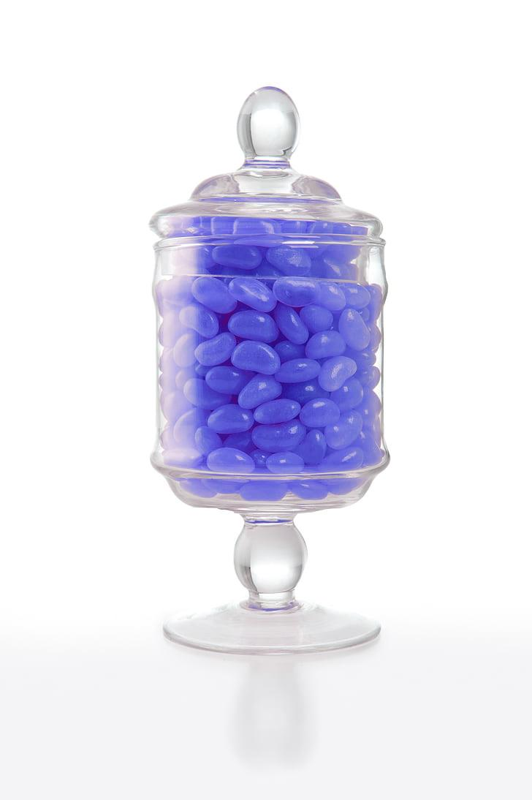
Questions? Suggestions?
Contact Us: library@uafs.edu
Jason Byrd, Director of Library Services Jason.Byrd@uafs.edu
Sierra Laddusaw, Scholarly Communication Librarian Sierra.Laddusaw@uafs.edu
Andrea Parton, Discovery & Access Librarian Andrea.Parton@uafs.edu
Notes:
https://www.hippopx.com/en/jelly-beans-lolly-jar-confectionery-sugar-glass-lolly-birthday-14111

