Slide 1
“Get on the Truth Train” Faculty Perceptions of Misinformation and Disinformation in the Classroom and in the Disciplines
Sarah Slaughter
LOEX 2023

Slide 2
Sarah Slaughter she/her Reference and Instruction Librarian sslaughter@dbq.edu
University of Dubuque
Dubuque, Iowa
Approximately 2,000 FTE
Graduate and Undergraduate
“Professional programs with a liberal arts core”

Slide 4
Misinformation is a problem for a democratic society
Students lack skills in identifying mis/disinformation (Breakstone et al, 2021)
Information literacy skills are an important tool (De Paor & Heravi, 2020)
Librarians are teaching on this topic using a variety of methods
Question: How are students learning about this in the rest of the curriculum?

Slide 5
Who is talking to faculty?
Most faculty feel it is important for students to understand how to identify false information (Saunders 2022; Weiss et al., 2020)
Faculty agree that information literacy skills are important for students (Delellis & Rubin, 2018)
Language use differences
Question: How do faculty in various disciplines think about mis/disinformation?

Slide 6
Research Questions
How do faculty across various subject areas perceive the impact of mis/disinformation in their discipline?
How do faculty incorporate issues of mis/disinformation into their curriculum?
How can librarians best support student learning on mis/disinformation related topics?

Slide 7
Methods
Full-time faculty
Stratified random sample
Subject area variability

Slide 8
Methods
Approved by IRB (October 2022)
14 in-depth interviews (Nov-Dec 2022)
Questionnaire
In the disciplines
In the classroom
Barriers/Resources
Transcribed interviews (Jan-March 2023)
Inductive thematic analysis (March-April 2023)

Slide 9
Preliminary Results

Slide 10
Major Themes
Describing mis/disinformation
Skills for identifying
Affect
Teaching methods
Barriers
Importance
Disciplinary

Slide 12
“A million times yes” “100% yes” “Yes, absolutely” “Definitely” “It’s very important”
Do you think it is important for students majoring in your subject area to understand how to identify mis/disinformation?

Slide 13
Disciplinary Impact
“I don’t get the sense that it’s changing what historians or American Studies people are doing.” – Arts & Humanities
“Most of the people I’ve had the pleasure of working with professionally are credible and have integrity and are trying to do the right thing.” – Social Sciences
“I feel like the disinformation comes more from the general public type of people who may or may not have credentials, but are visible in Celebrity Realms, social media Realms, pro athlete Realms, you know that type of thing.” – Natural & Health Sciences
“I really don’t think there’s any within my Special Interest Groups and stuff like that, I don’t see anybody trying to teach anything wrong - it's just within our colleges or within the training programs, just making sure they have the content.” – Social Sciences

Slide 18
What skills do you think students need in order to successfully identify mis/disinformation?
Affective dimensions
Skepticism – 3 interviews
Open-mindedness -2 interviews
Emotional Regulation -2 interviews
Frequency of theme mentioned

Slide 19
…when you do initial searches, they just need to learn a little more of how to do deeper searches in their research, I guess. Because yeah, it's that initial thing that pops up - and it just makes me think of the social media, when they have it in their face like oh there it is! No, you gotta look a little farther into it, I guess.
I don't always get as much mis or disinformation but maybe things that are just sloppy research, or you know from a blog, that type of thing that isn't from somebody who’s avid in the field
…no matter the topic, it’s just the first things that pop up when they’re searching on the internet – they’ll rely on those. Or, using information from organizations that are specifically looking for a really narrow angle that they’re trying to either lobby for, or emphasize, so some of the things we talk about in the library sessions where it’s like, “what’s the purpose of this organization?” So students are still falling for that.

Slide 20
I can only think of one student who kind of had an agenda already and was trying to find specific things, which would angle more toward the disinformation related to student loans and forgiving them or not forgiving them… [his argument was] the only forgiveness should be through military service – and only active duty, not even like national guard or anything like that, you have to be deployed overseas and fight in a war. – Arts & Humanities
One student that really stuck out, who was an incredible public speaker, like bright kid, was doing a speech on why we need to only do in-person voting. No early voting, like it all has to occur in-person. And all of his sources were quotes from President Trump…so we talked about, I'm like if your goal is to persuade people who disagree with you on this topic, is President Trump the most credible source that you could use for this? And his response was, “Frankly I don't care what they think, they can get on the truth train or get run over.” – Social Sciences

Slide 21
Addressing Mis/Dis in the Classroom

Slide 22
Barriers
Student motivation is a significant concern
Faculty are careful about discussing mis/disinformation with students

Slide 23
I think too, one reason I've maybe -not that I think about this on a conscious level- but I think I don't want to alienate any students, and so I think I'm careful about if I say something, if I'm pointing that something out is asinine or misinformed or whatever, I'll try to do it in a way that kind of tries to depoliticize it or something.
– Arts & Humanities
Emotions play a significant role with this topic
…some of the areas that we discuss can be very controversial a little bit, so I probably don't wade into those too much, unless somebody directly asks something, just because when you get into those areas, because they are so charged emotionally sometimes, it's hard for people to step back and think rationally, and it doesn't do any good for me to kind of discuss something where somebody's feeling very strongly about it.
- Health Sciences
I feel like, unless it's a one-on-one conversation, and repeated one-on-one conversations with students, I just don't feel like I'm heard or it's sinking in.
– Social Sciences

Slide 24
Key Findings
Yes, this topic is important to faculty
Key skills: Knowledge of authorities, critical thinking, source variety, digging deeper
Relevant to a wide variety of disciplines
Most commonly included as an assignment requirement
Student motivation, and fear of backlash are barriers to engagement on these topics

Slide 25
Opportunities for Collaboration
86% of participants want to see these topics integrated across the curriculum
43% expressed a desire to do more in their own classrooms
“I think resources that could be easily Plug-and-Play dropped into the classroom I think would be really fantastic, and I’m sure some out there exist, but I'm not aware of them. So, a lack of awareness in terms of classroom resources related to mis/disinformation would be a barrier too” – Natural Sciences
Discuss: What can librarians do to address this need?
What similarities or differences do you see on your campuses?

Slide 26
Acknowledgements
Institute for Research Design in Librarianship
Eamon Tewell
Iowa Association of Private Academic Libraries
Richard Fyffe Scholarship

Slide 27
Selected Bibliography
Breakstone, J., Smith, M., Wineburg, S., Rapaport, A., Carle, J., Garland, M., & Saavedra, A. (2021). Students’ civic online reasoning: A national portrait. Educational Researcher, 50(8), 505–515.
De Paor, S., & Heravi, B. (2020). Information literacy and fake news: How the field of librarianship can help combat the epidemic of fake news. Journal of Academic Librarianship, 46(5), 1-8.
Delellis, N. S., & Rubin, V. L. (2018). Educators’ perceptions of information literacy and skills required to spot ‘fake news.’ Proceedings of the Association for Information Science and Technology, 55(1), 785–787.
Saunders, L. (2022). Faculty Perspectives on Mis-and Disinformation across Disciplines. College & Research Libraries, 83(2), 221–245.
Weiss, A. P., Alwan, A., Garcia, E. P., & Garcia, J. (2020). Surveying fake news: Assessing university faculty’s fragmented definition of fake news and its impact on teaching critical thinking. International Journal for Educational Integrity, 16(1), 1-30.

Slide 28
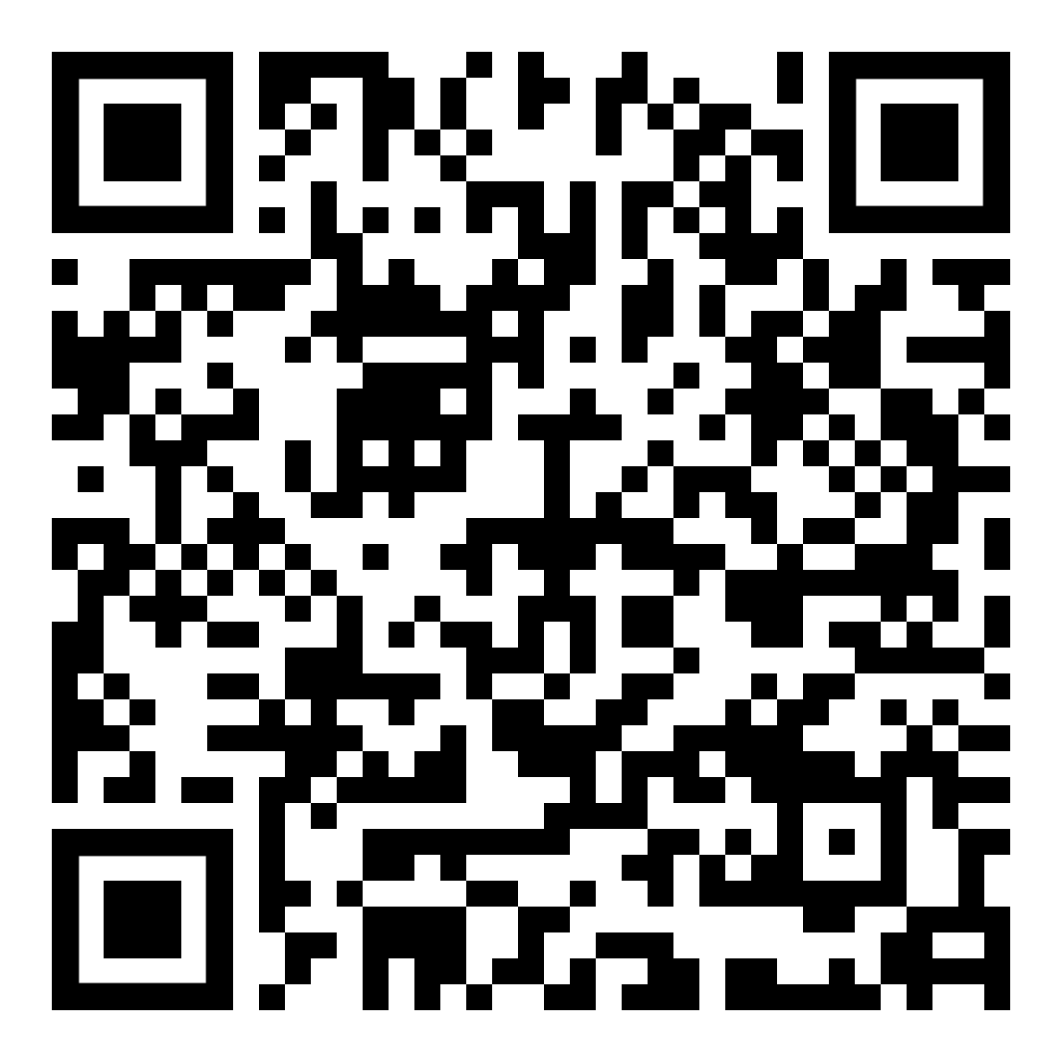
Sarah Slaughter Reference and Instruction Librarian sslaughter@dbq.edu
Full bibliography and interview questions

